Slide 1
Notes
G19.3 Glockstore Heavy Tungsten Guide Rod Assembly for Glock replacement, Aug 2024
Hellcat Pro Apex trigger upgrade 12/2024
CZ SP01 Cajun Gunworks upgrade 12/2024

Slide 2
Cleaning
Gun | Shots | Cleaned | Shots | Cleaned | Shots | Cleaned | Shots | Cleaned | Shots | Cleaned | Shots | Cleaned
SP01 | 260 | 8/6/25 | 405 | 5/4/26 | 99+151
PCR |  | 8/6/25 | 100 +
1911 | 148 | 5/1/25 | 213 | 5/6/26 | 120+56
G19.2 |  | 1/1/25
G19.3 | 80 | 5/1/25 | 80+120+50
HCP | 100 | 5/1/25 | 135 & carry | 4/14/26 | 90 & carry | 8/4/26
.357 |  | 1/1/25
.38 |  | 1/1/25
Mossberg 500 | 10+20+10

Slide 3
Date:
Guns:
Notes:

Slide 4
Date: 9/8/26
Guns: Marlin
.357 Magnum (50)
14 @ 10y
14 @ 15y
28 @ 20y
.38 Special
50 @ 20y
Notes:
28 @ 20y (.357)
7 @ 10y (.357)
7 @ 10y (.357)
7 @ 10y (357)
50 @ 20 y (.38)

Slide 5
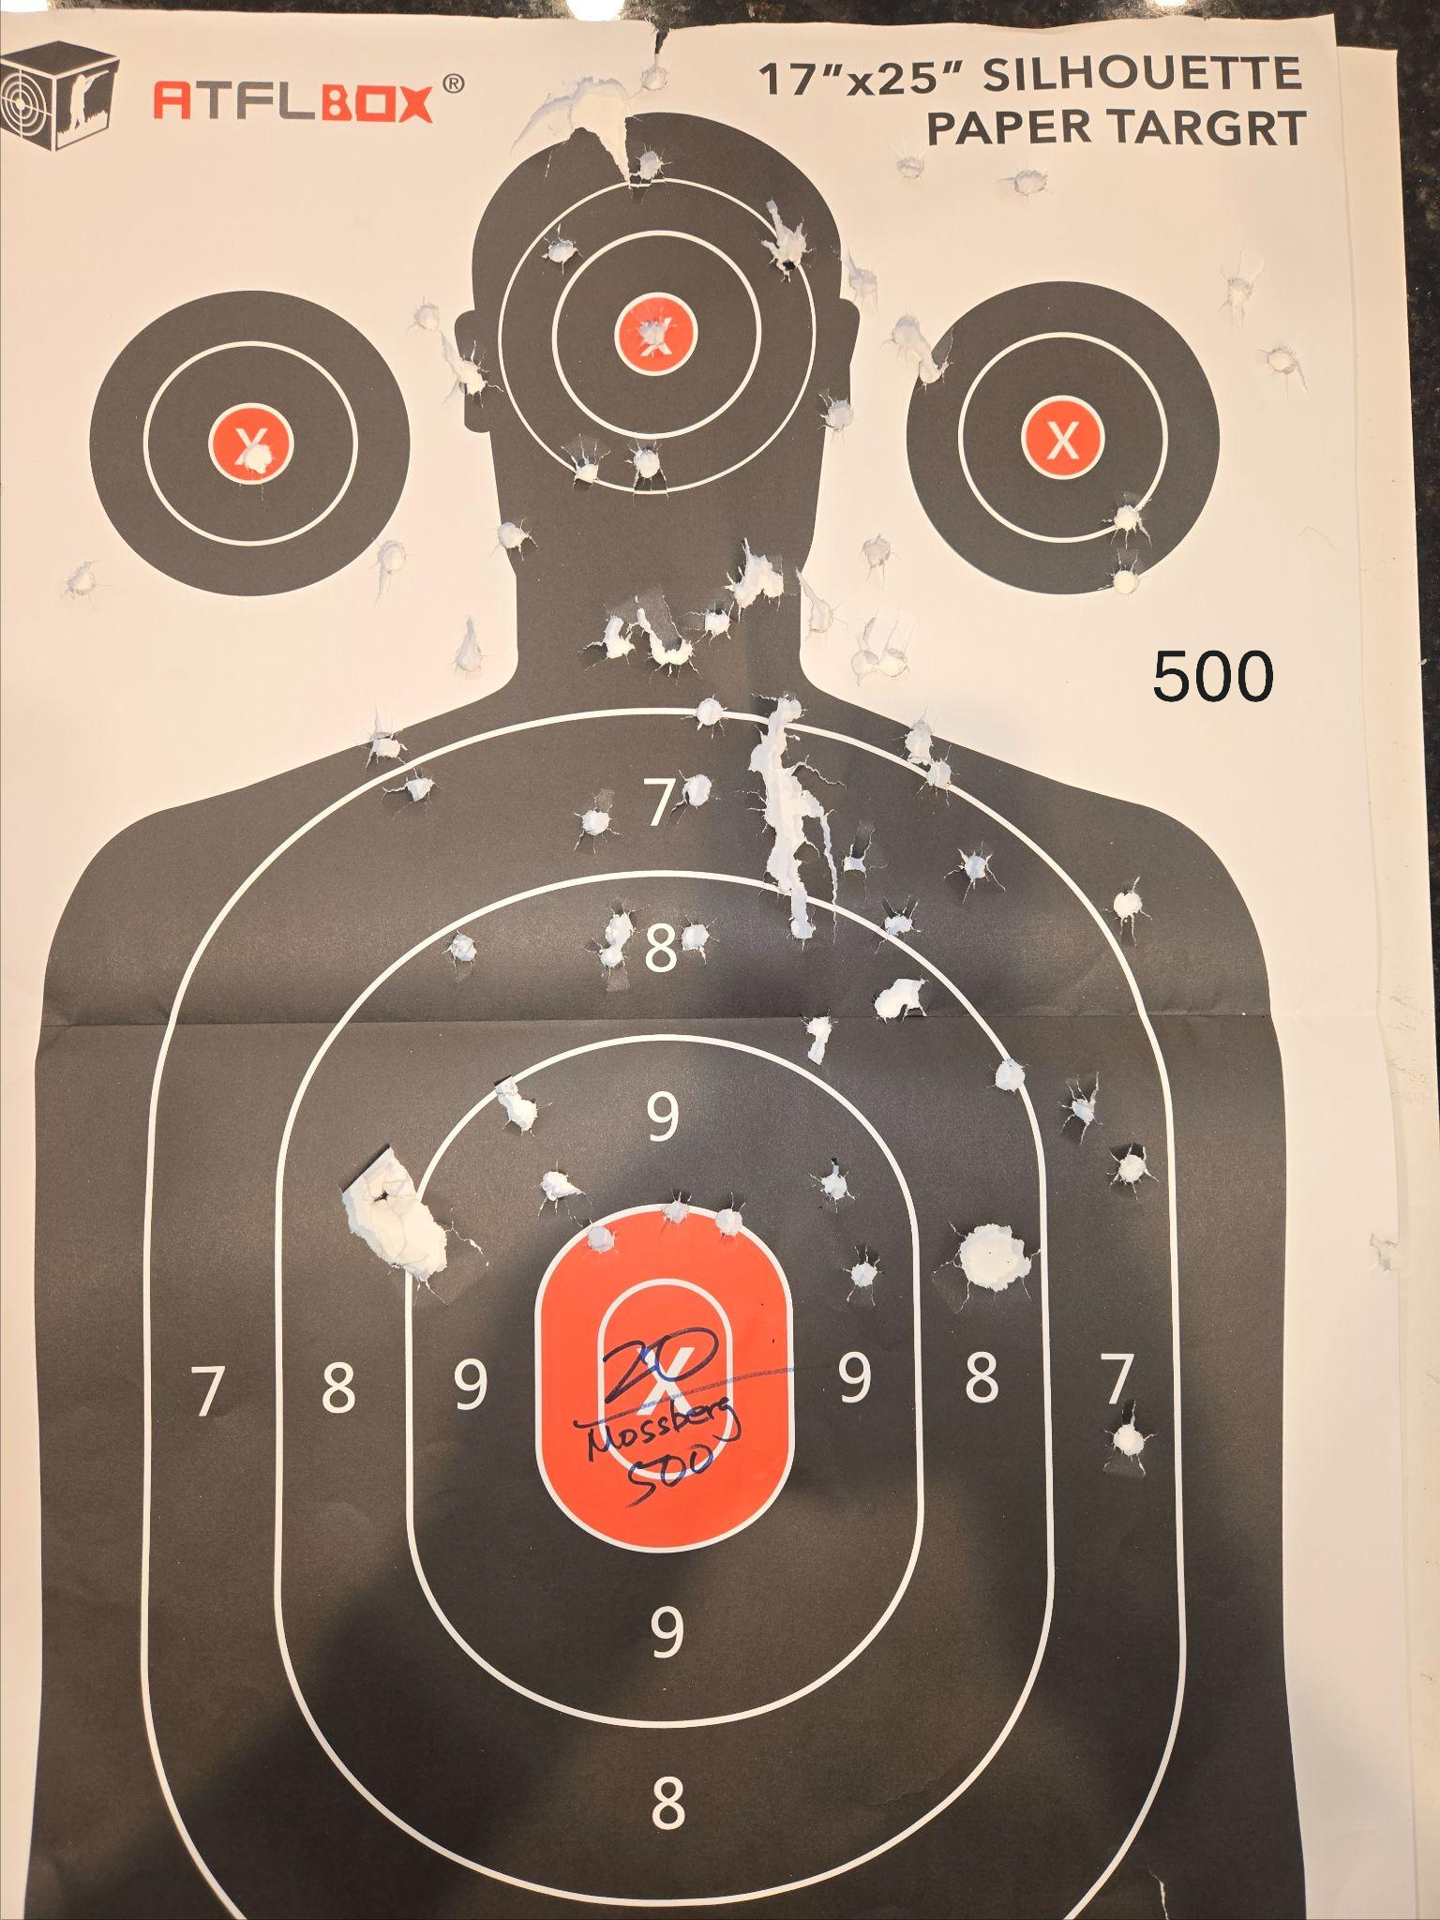
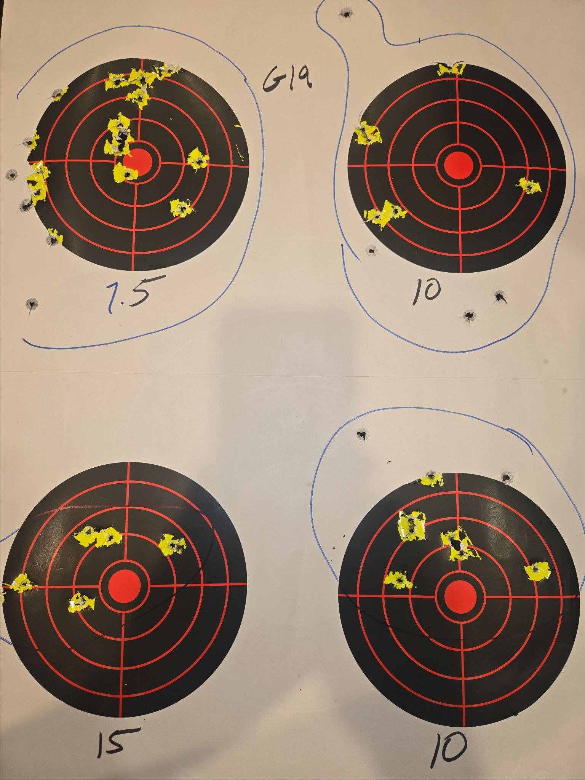
Date: 9/1/26
Guns:
500 (10)
G19.3 (50)
1911 (56)
Notes:

Slide 6
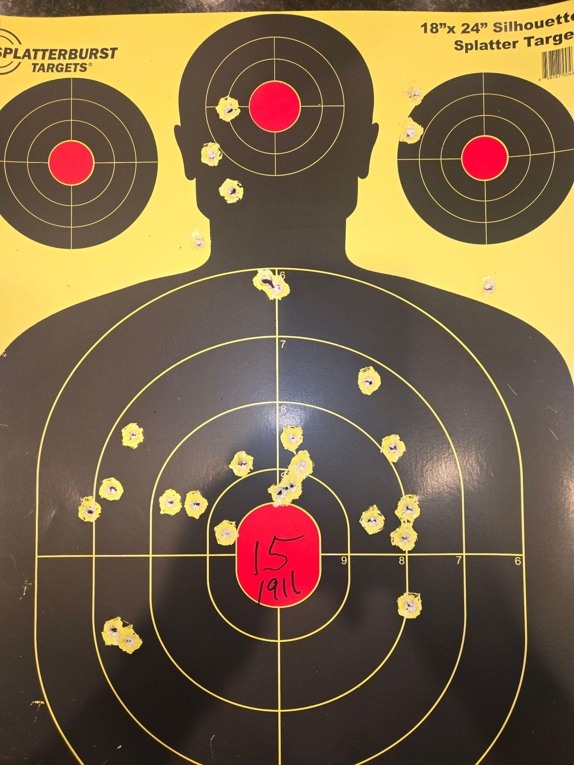
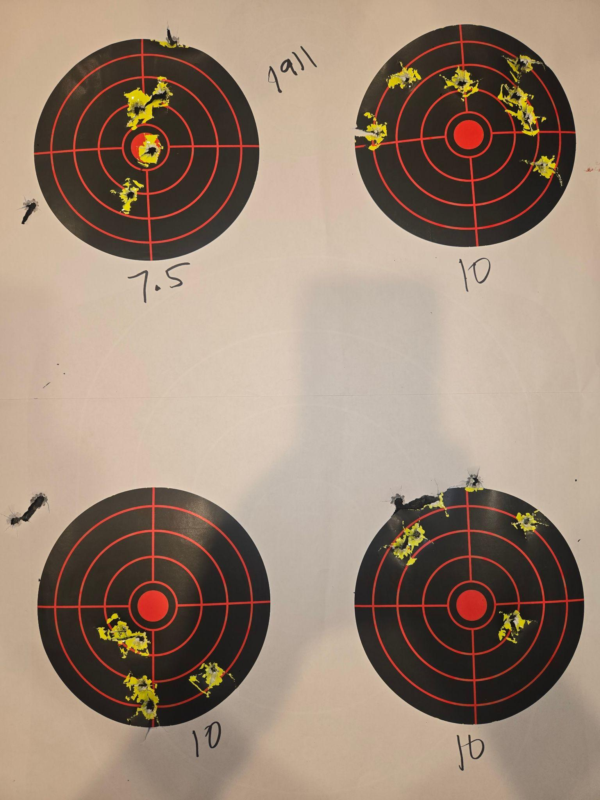
Date: 9/1/26
Guns:
500 (10)
G19.3 (50)
1911 (56)
Notes:

Slide 7
Date: 7/25/26
Guns:
SP01 (151)
1911 (120)
HCP (30)
Notes:
Shooting on BLM land in Nevada.
Dusty
shot :
Mossberg 500: clay
Marlin lever action
Ruger American: steel @ 175yds
Sig 226
Sig 320
.22 bolt action

Slide 8
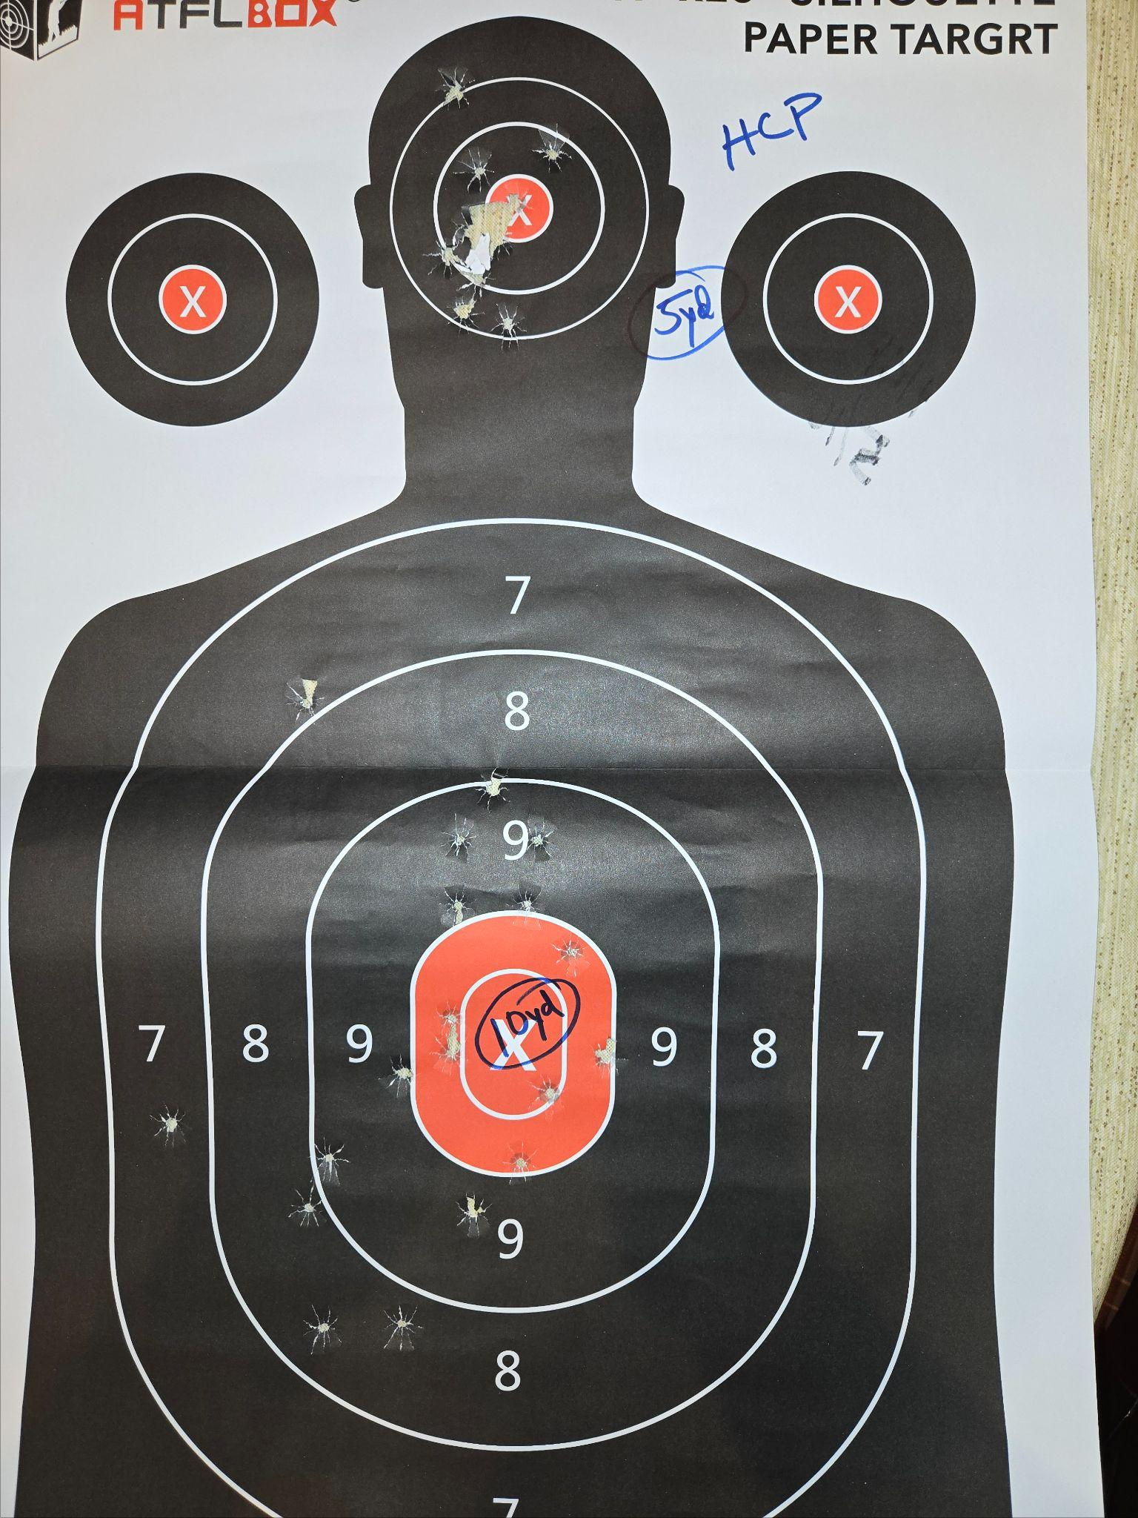
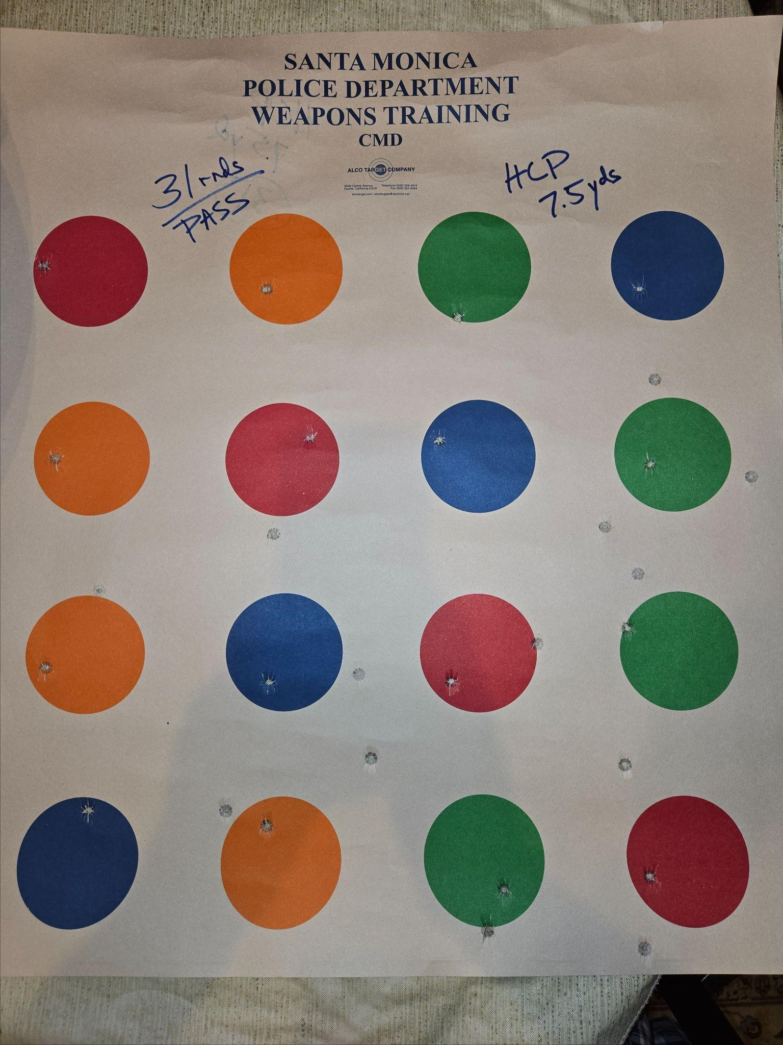
Date: 5/19/26
Guns: HCP (61)
SP01 (99)
Notes:
Challenge: clean hit on each bubble
Did it with 31 shots

Slide 9
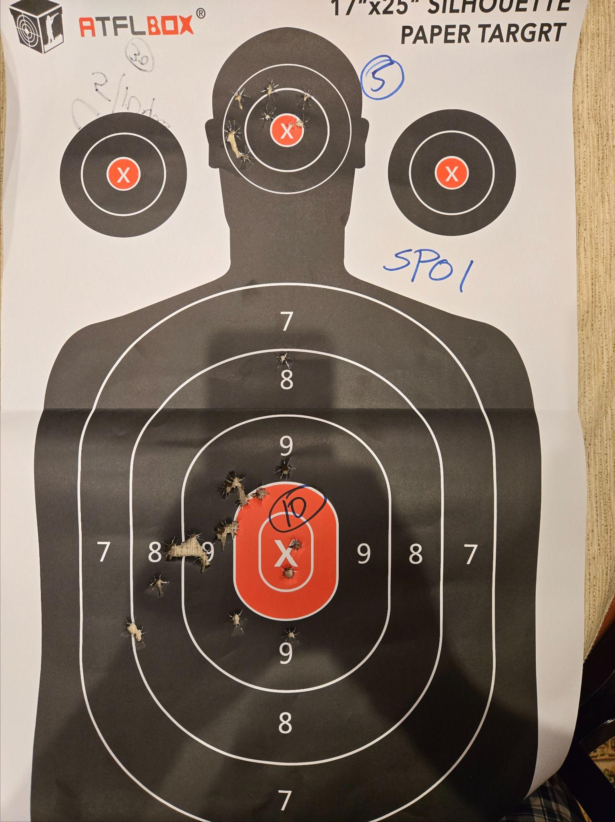
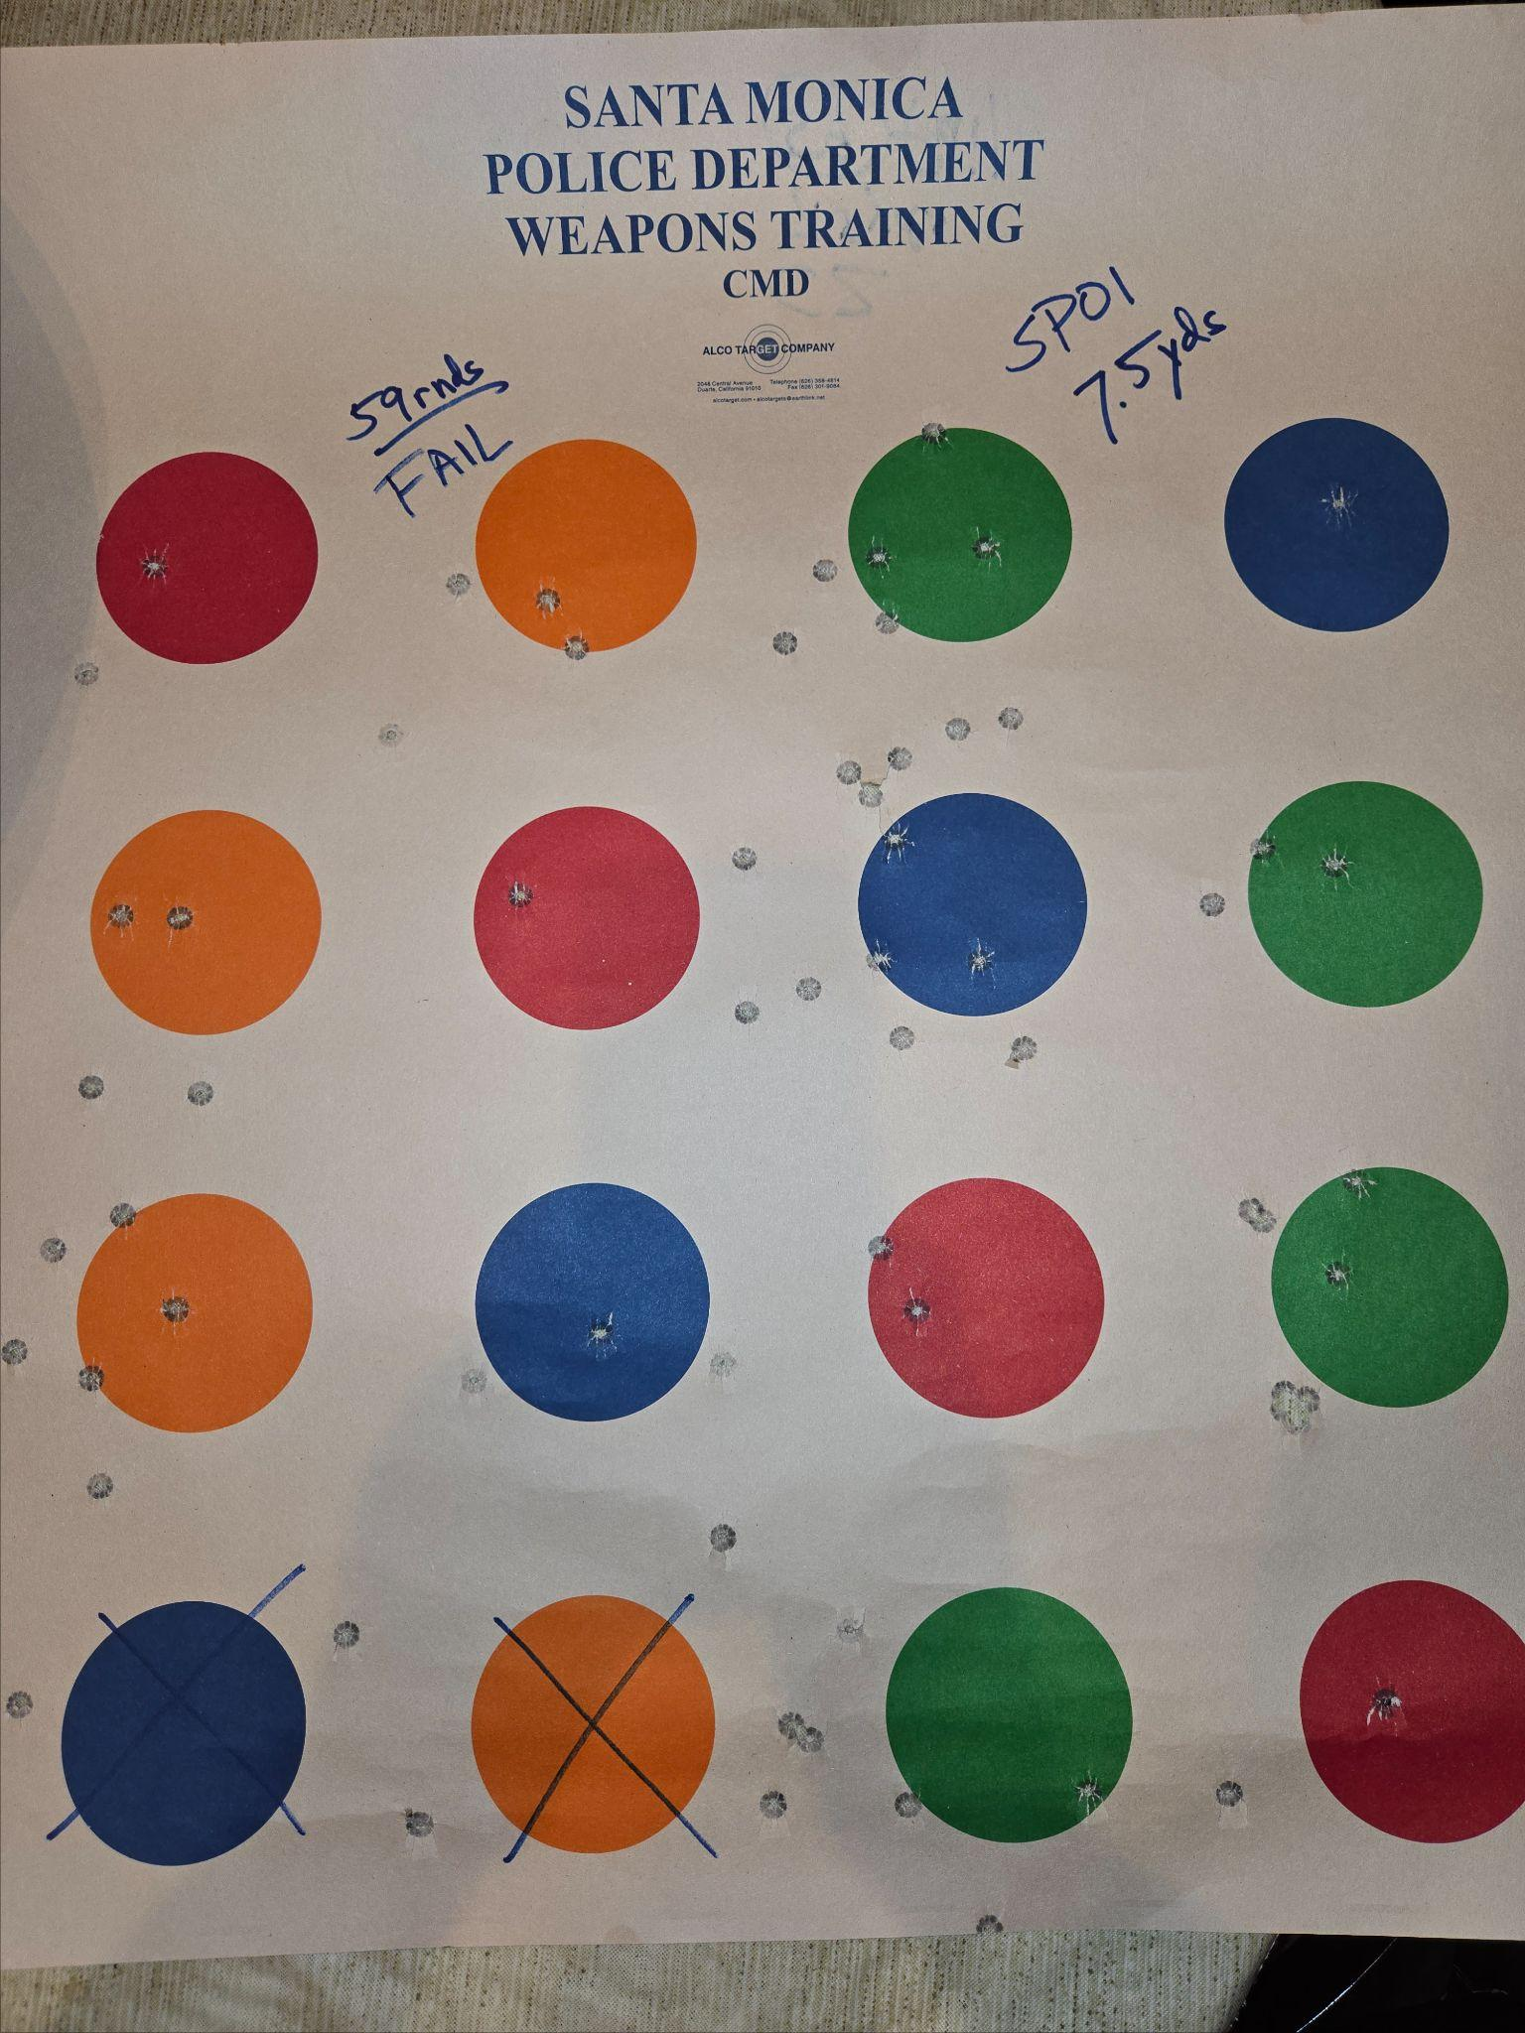
Date: 5/19/26
Guns: SP01 (99)
Notes:
Challenge: clean hit on each bubble
Left 2 open on 69 shots
69 shots

Slide 10
Date: 5/3/26
Guns:
Glock 19.3 (120)
CZ SP01 (140)
1911 (128)
Notes:
Shooting with Bob
BOBIE

Slide 11
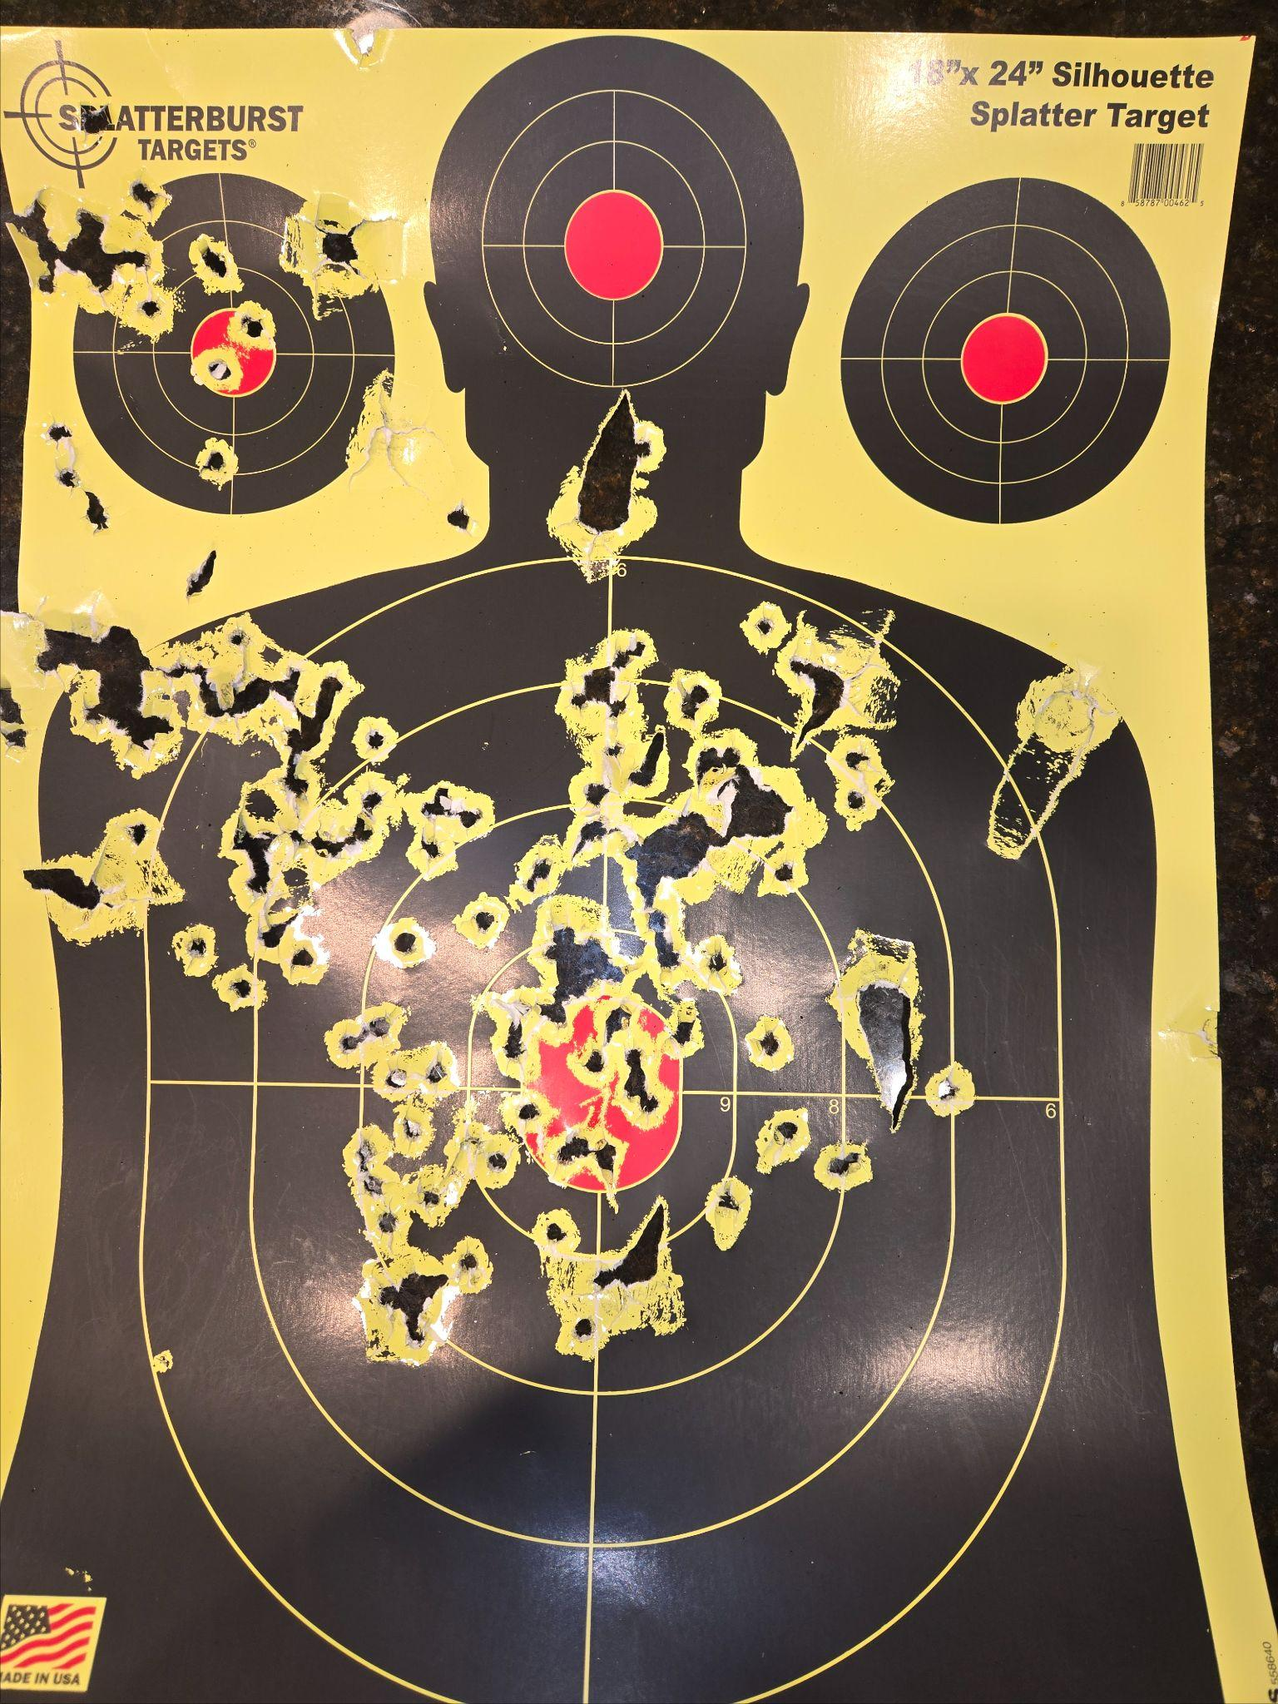
Date: 4/22/26
Guns:
Mossberg 500
(20 #00)
Notes:
First 2 shots @ 15y missed COMPLETELY
Aiming low to get these hits

Slide 12
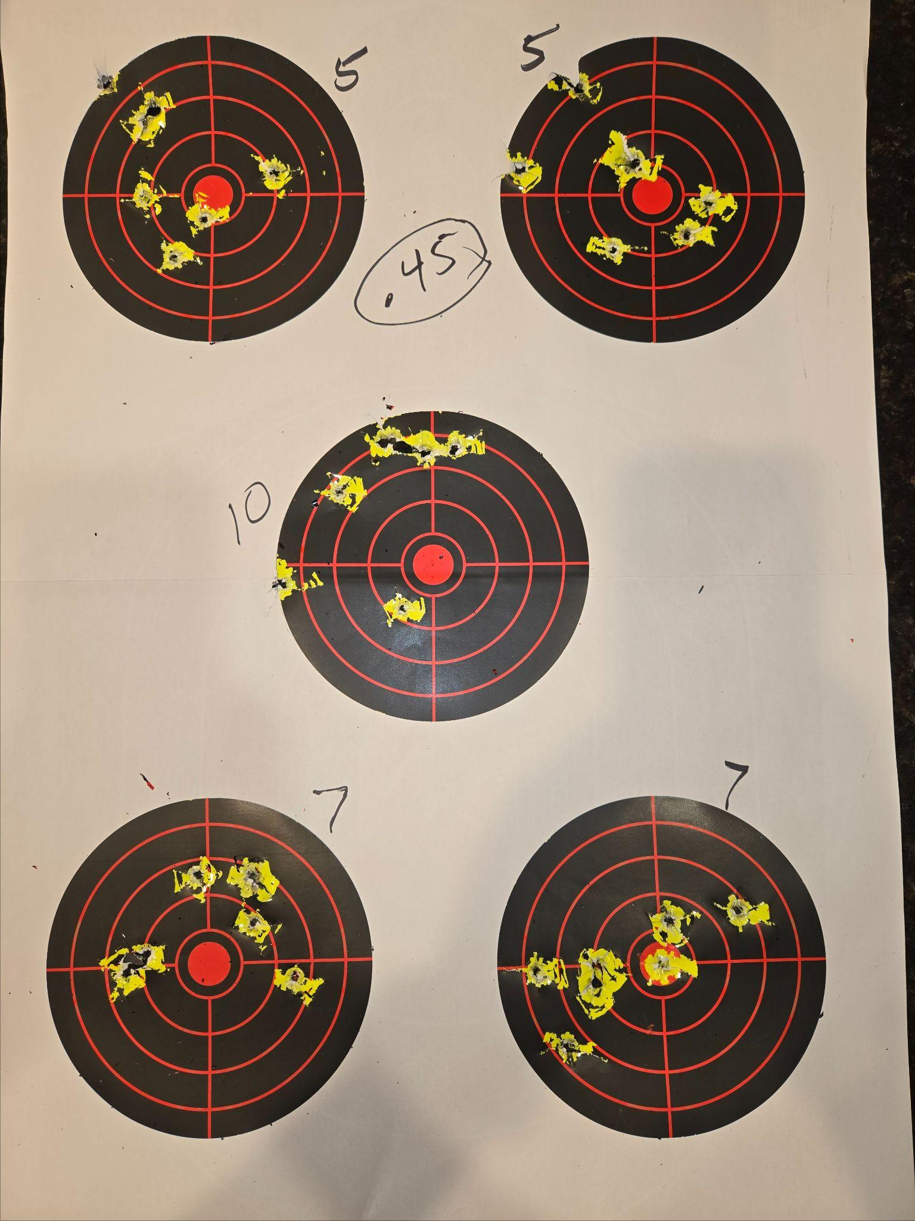
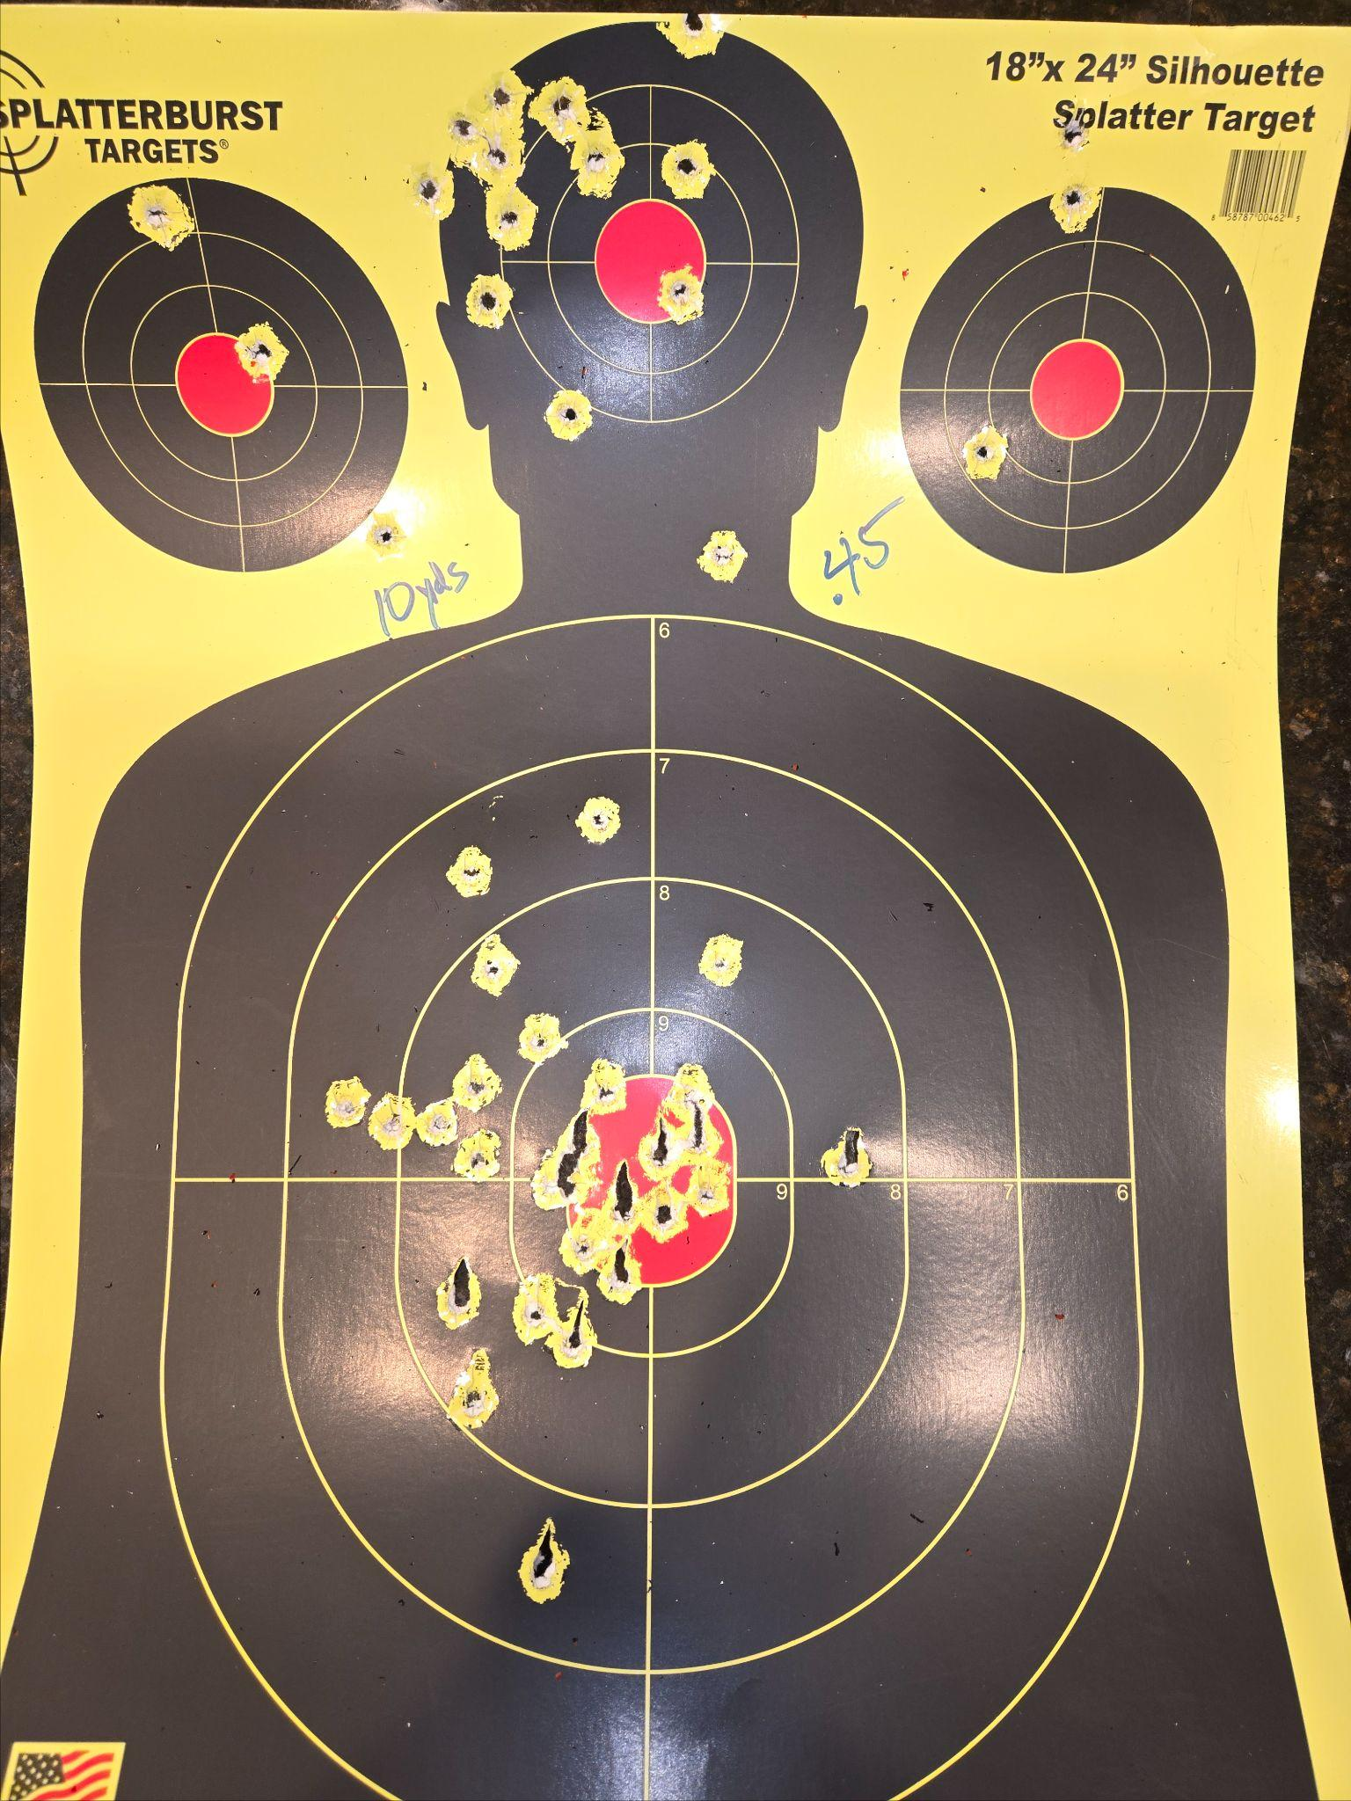
Date: 4/22/26
Guns:
1911 (85)
Notes:

Slide 13
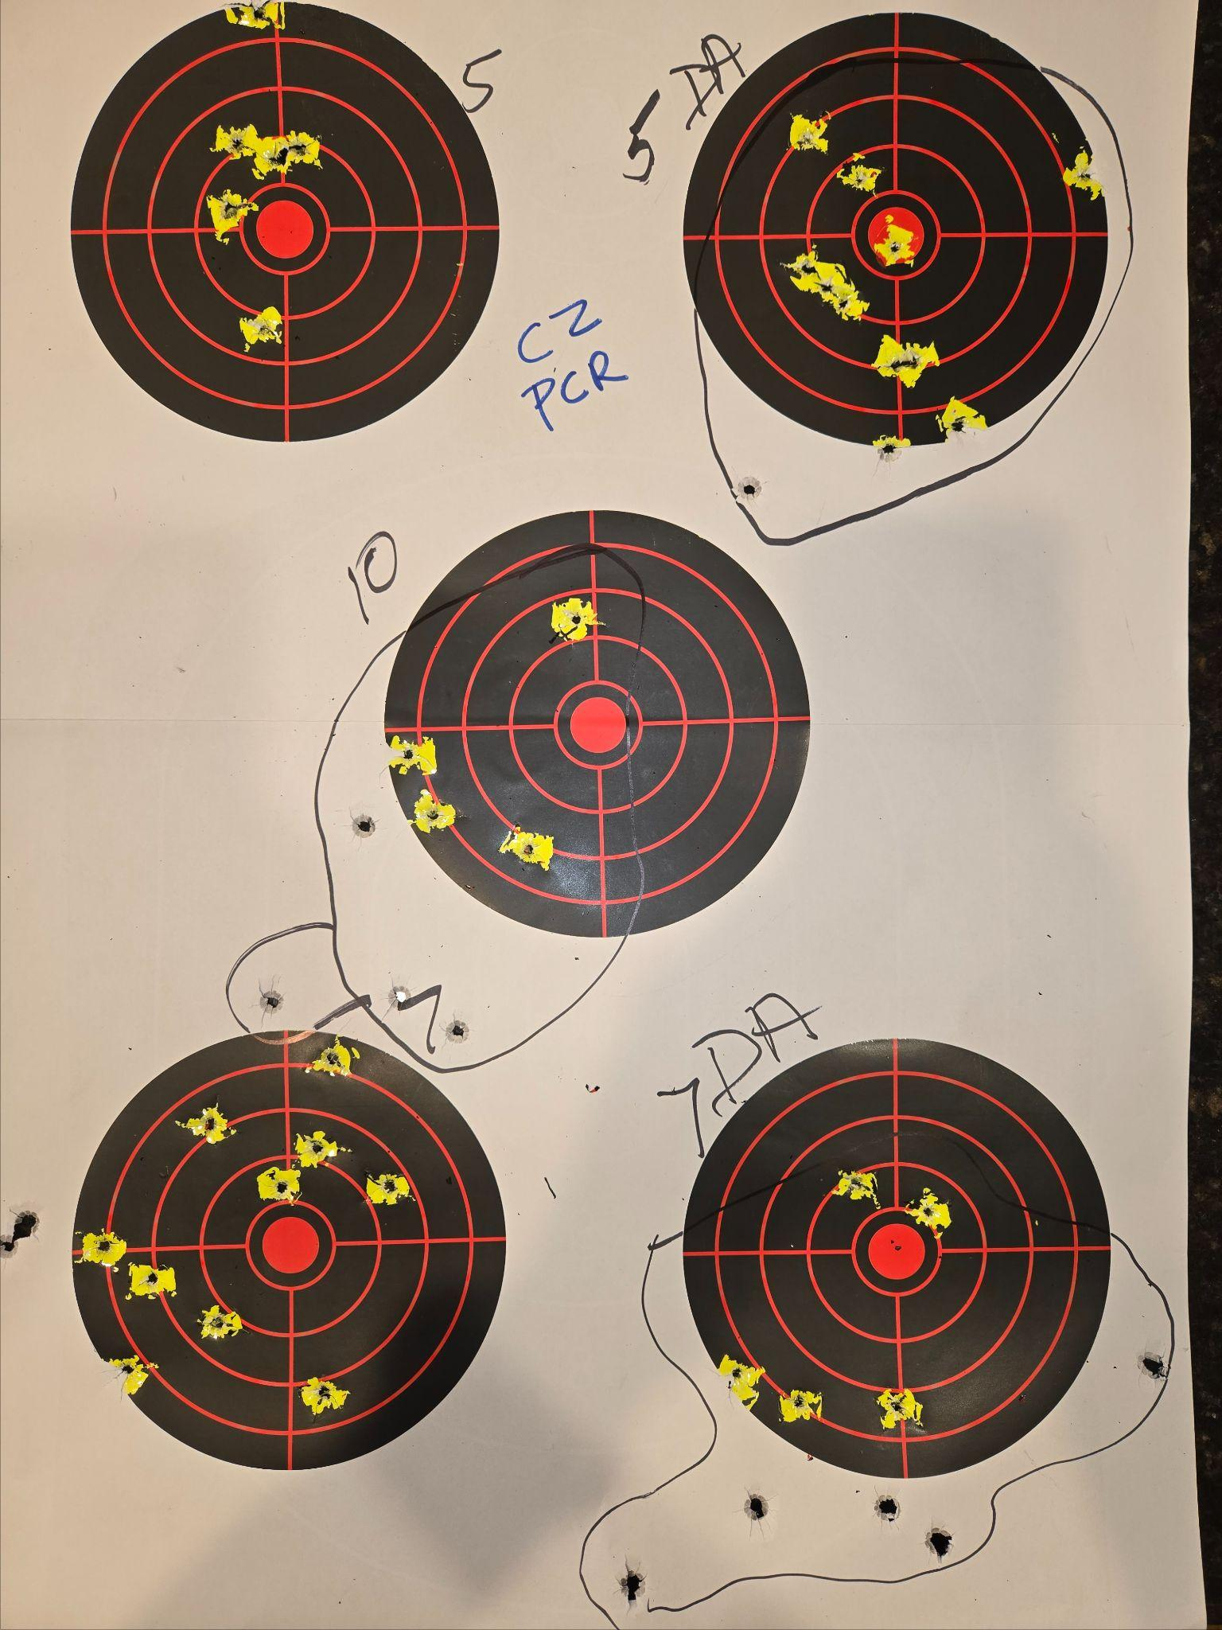
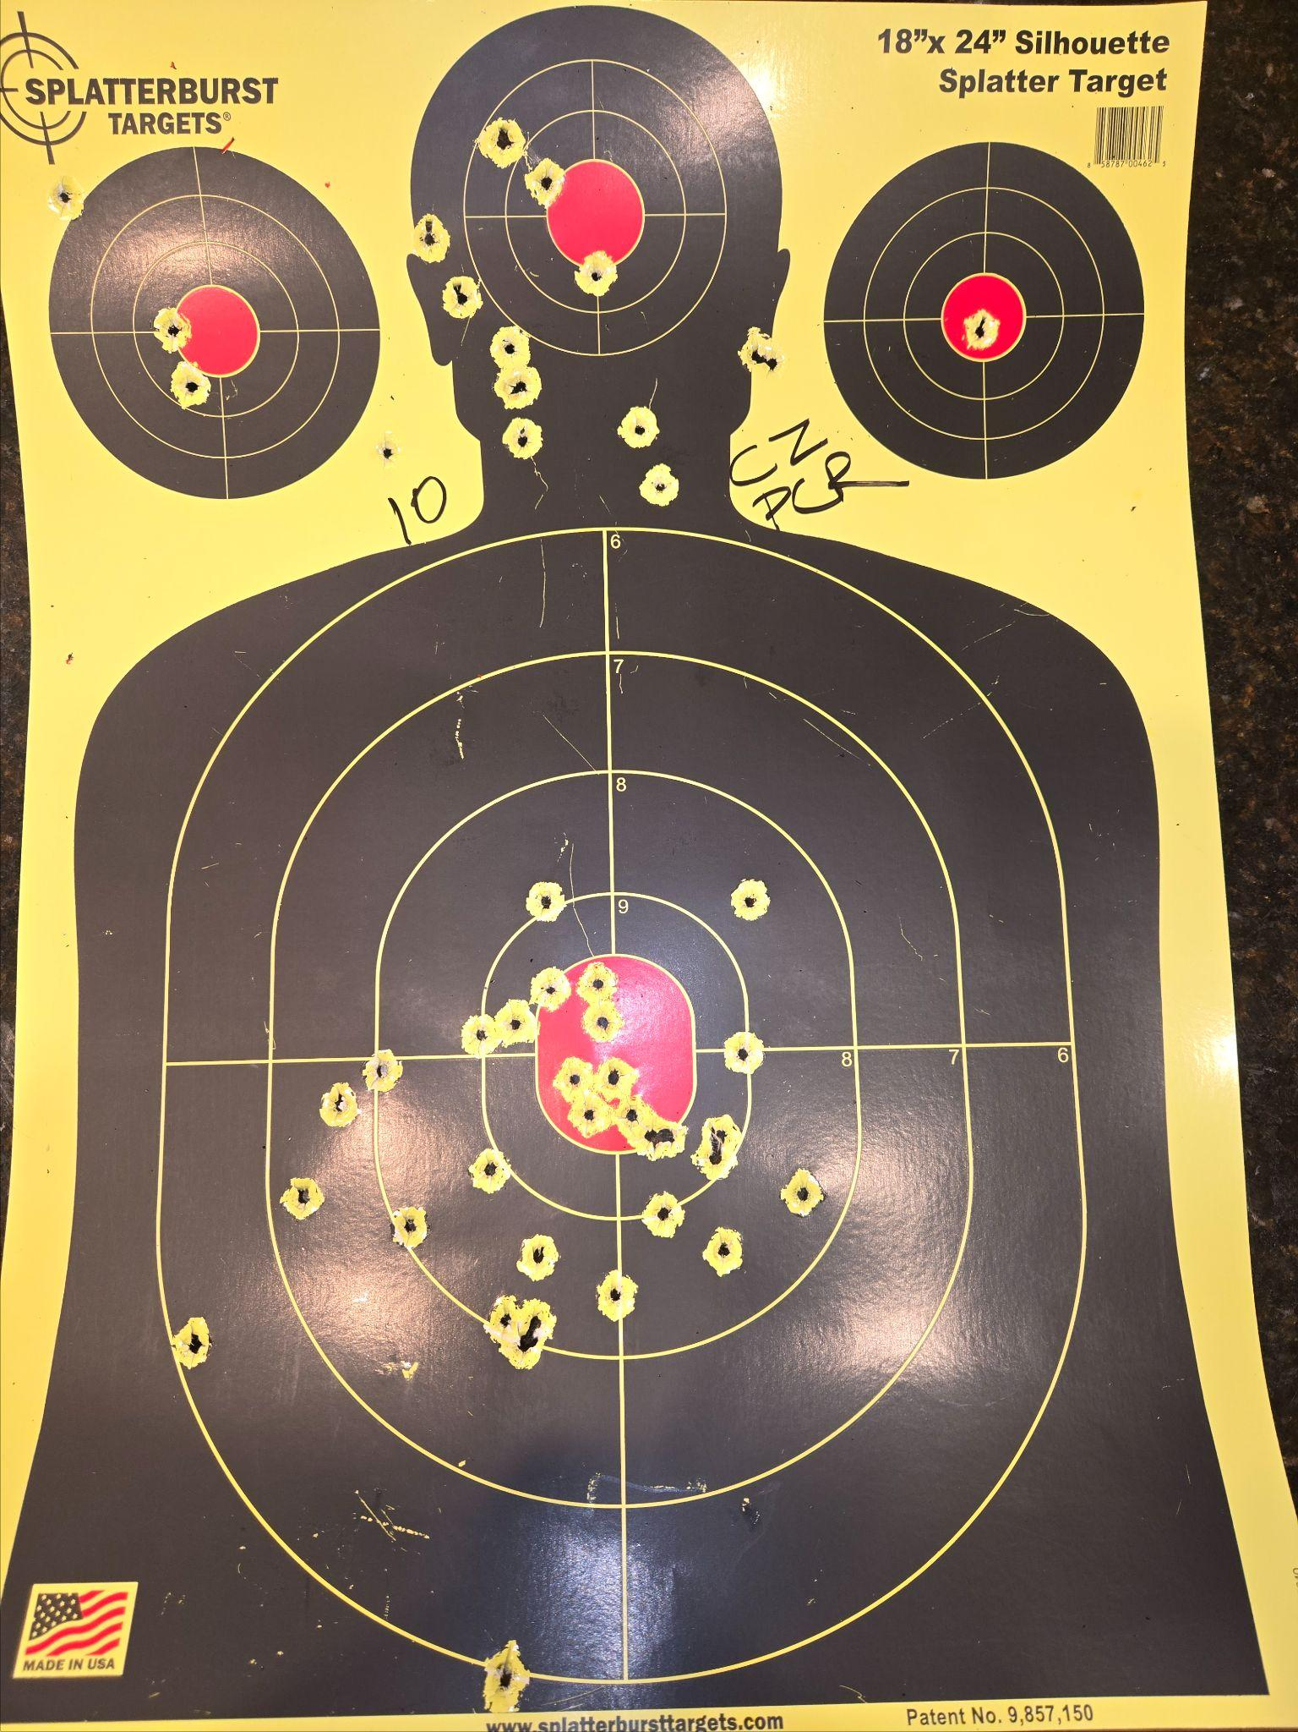
Date: 4/22/26
Guns:
CZ PCR (100)
Notes:
Practiced shooting half-cocked (DA)

Slide 14
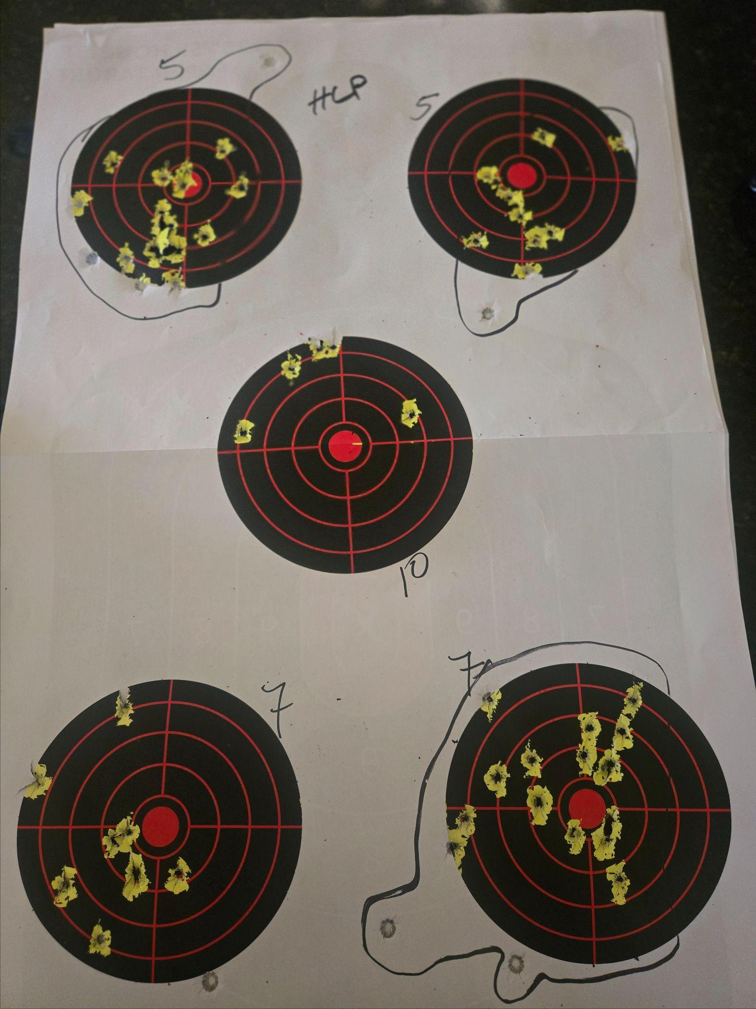
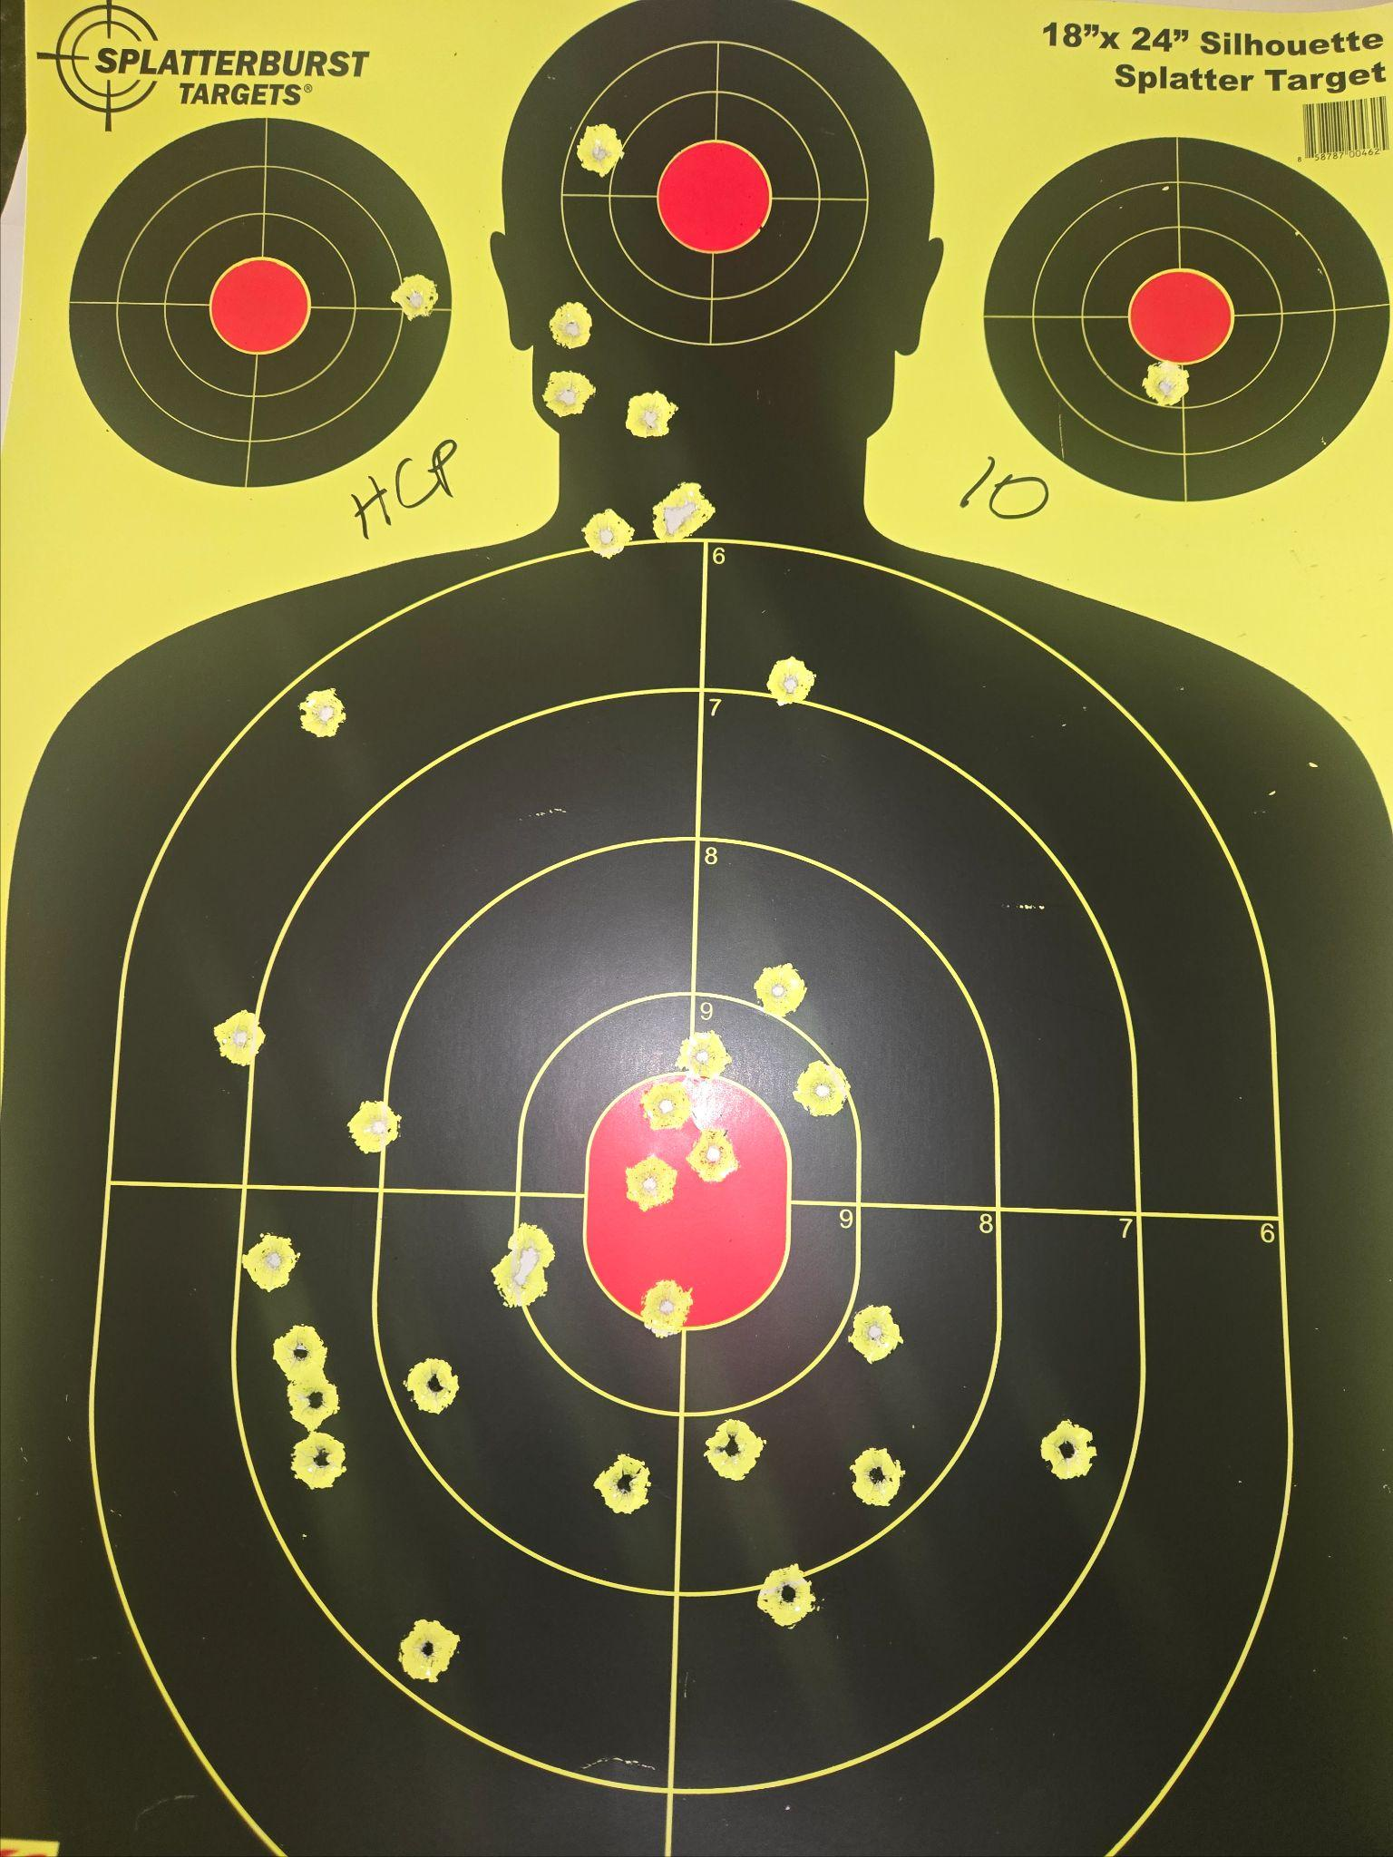
Date: 4/14/26
Guns:
HCP (185)
Notes:
Shooting pretty fast
On silhouette:
body/body/head
x 3
Then shoot hostage w/ last shot

Slide 15
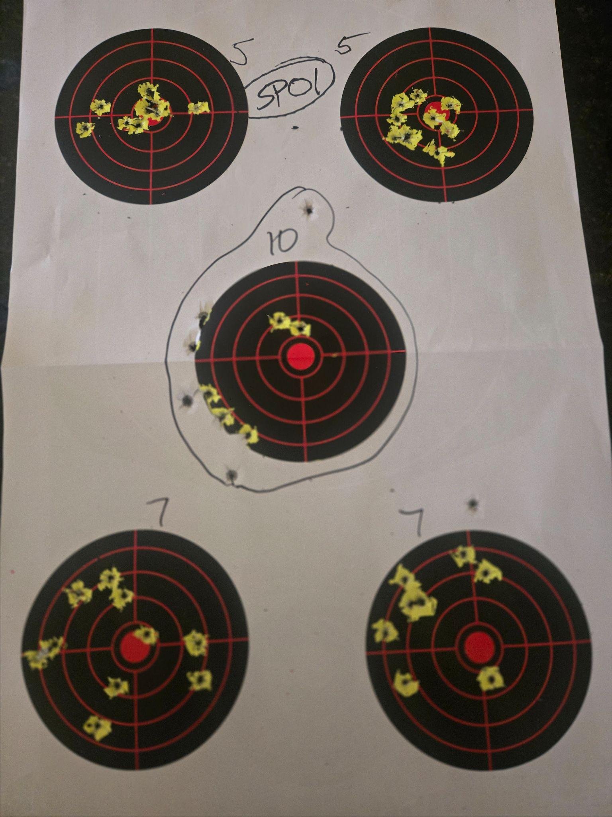
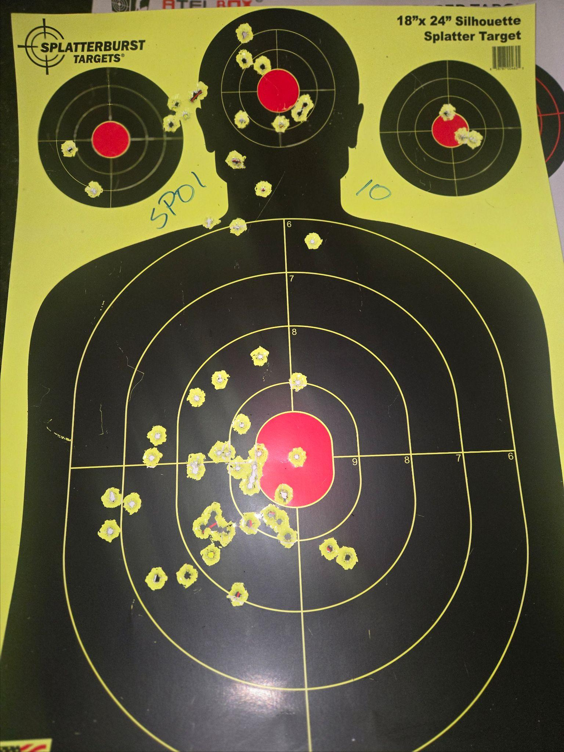
Date: 4/14/26
Guns:
CZ SP01 (185)
Notes:
Shooting pretty fast
On silhouette:
body/body/head
x 3
Then shoot hostage w/ last shot

Slide 16
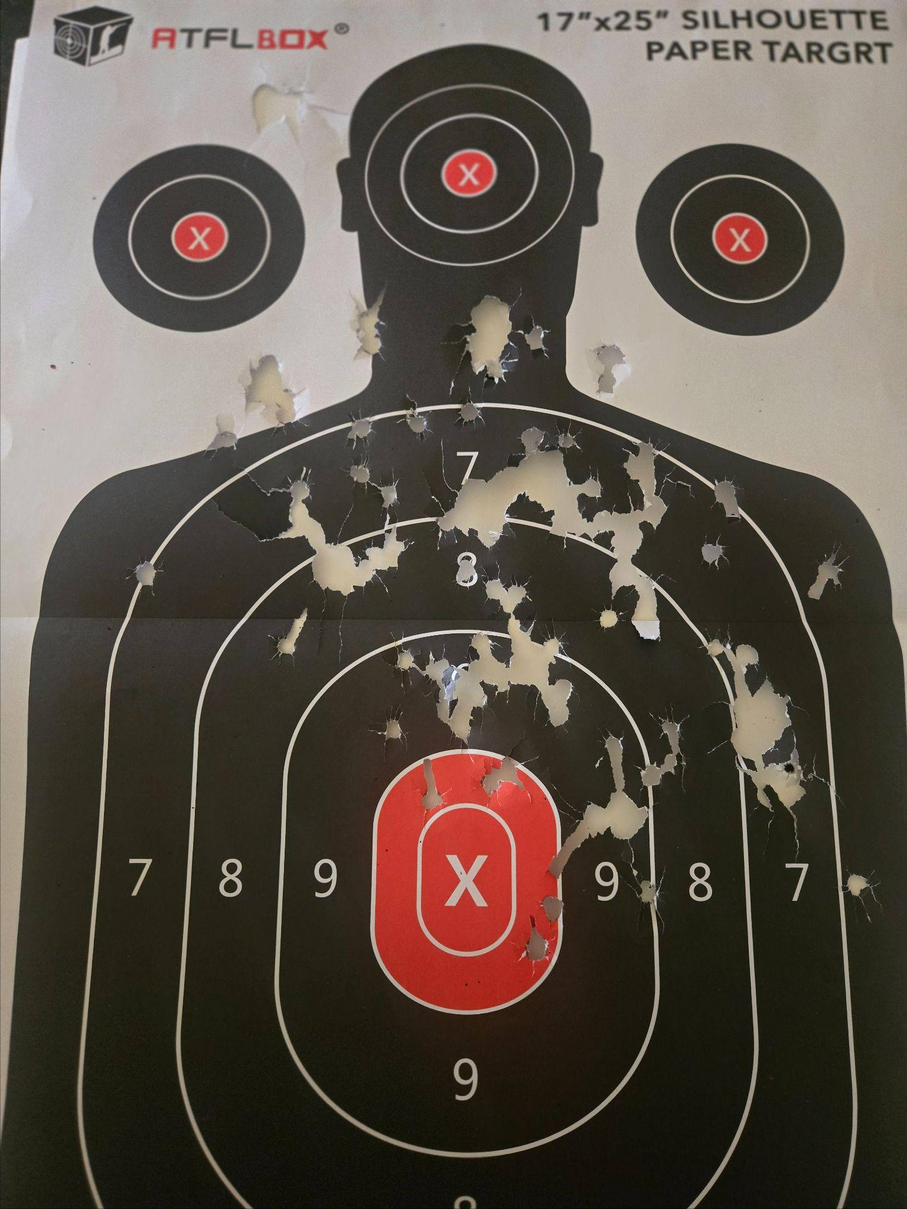
Date: 4/14/26
Guns:
Mossberg 500
(10 #00)
Notes:
Orig stock feels too long
Need to remember to cycle after shots
10yds

Slide 17
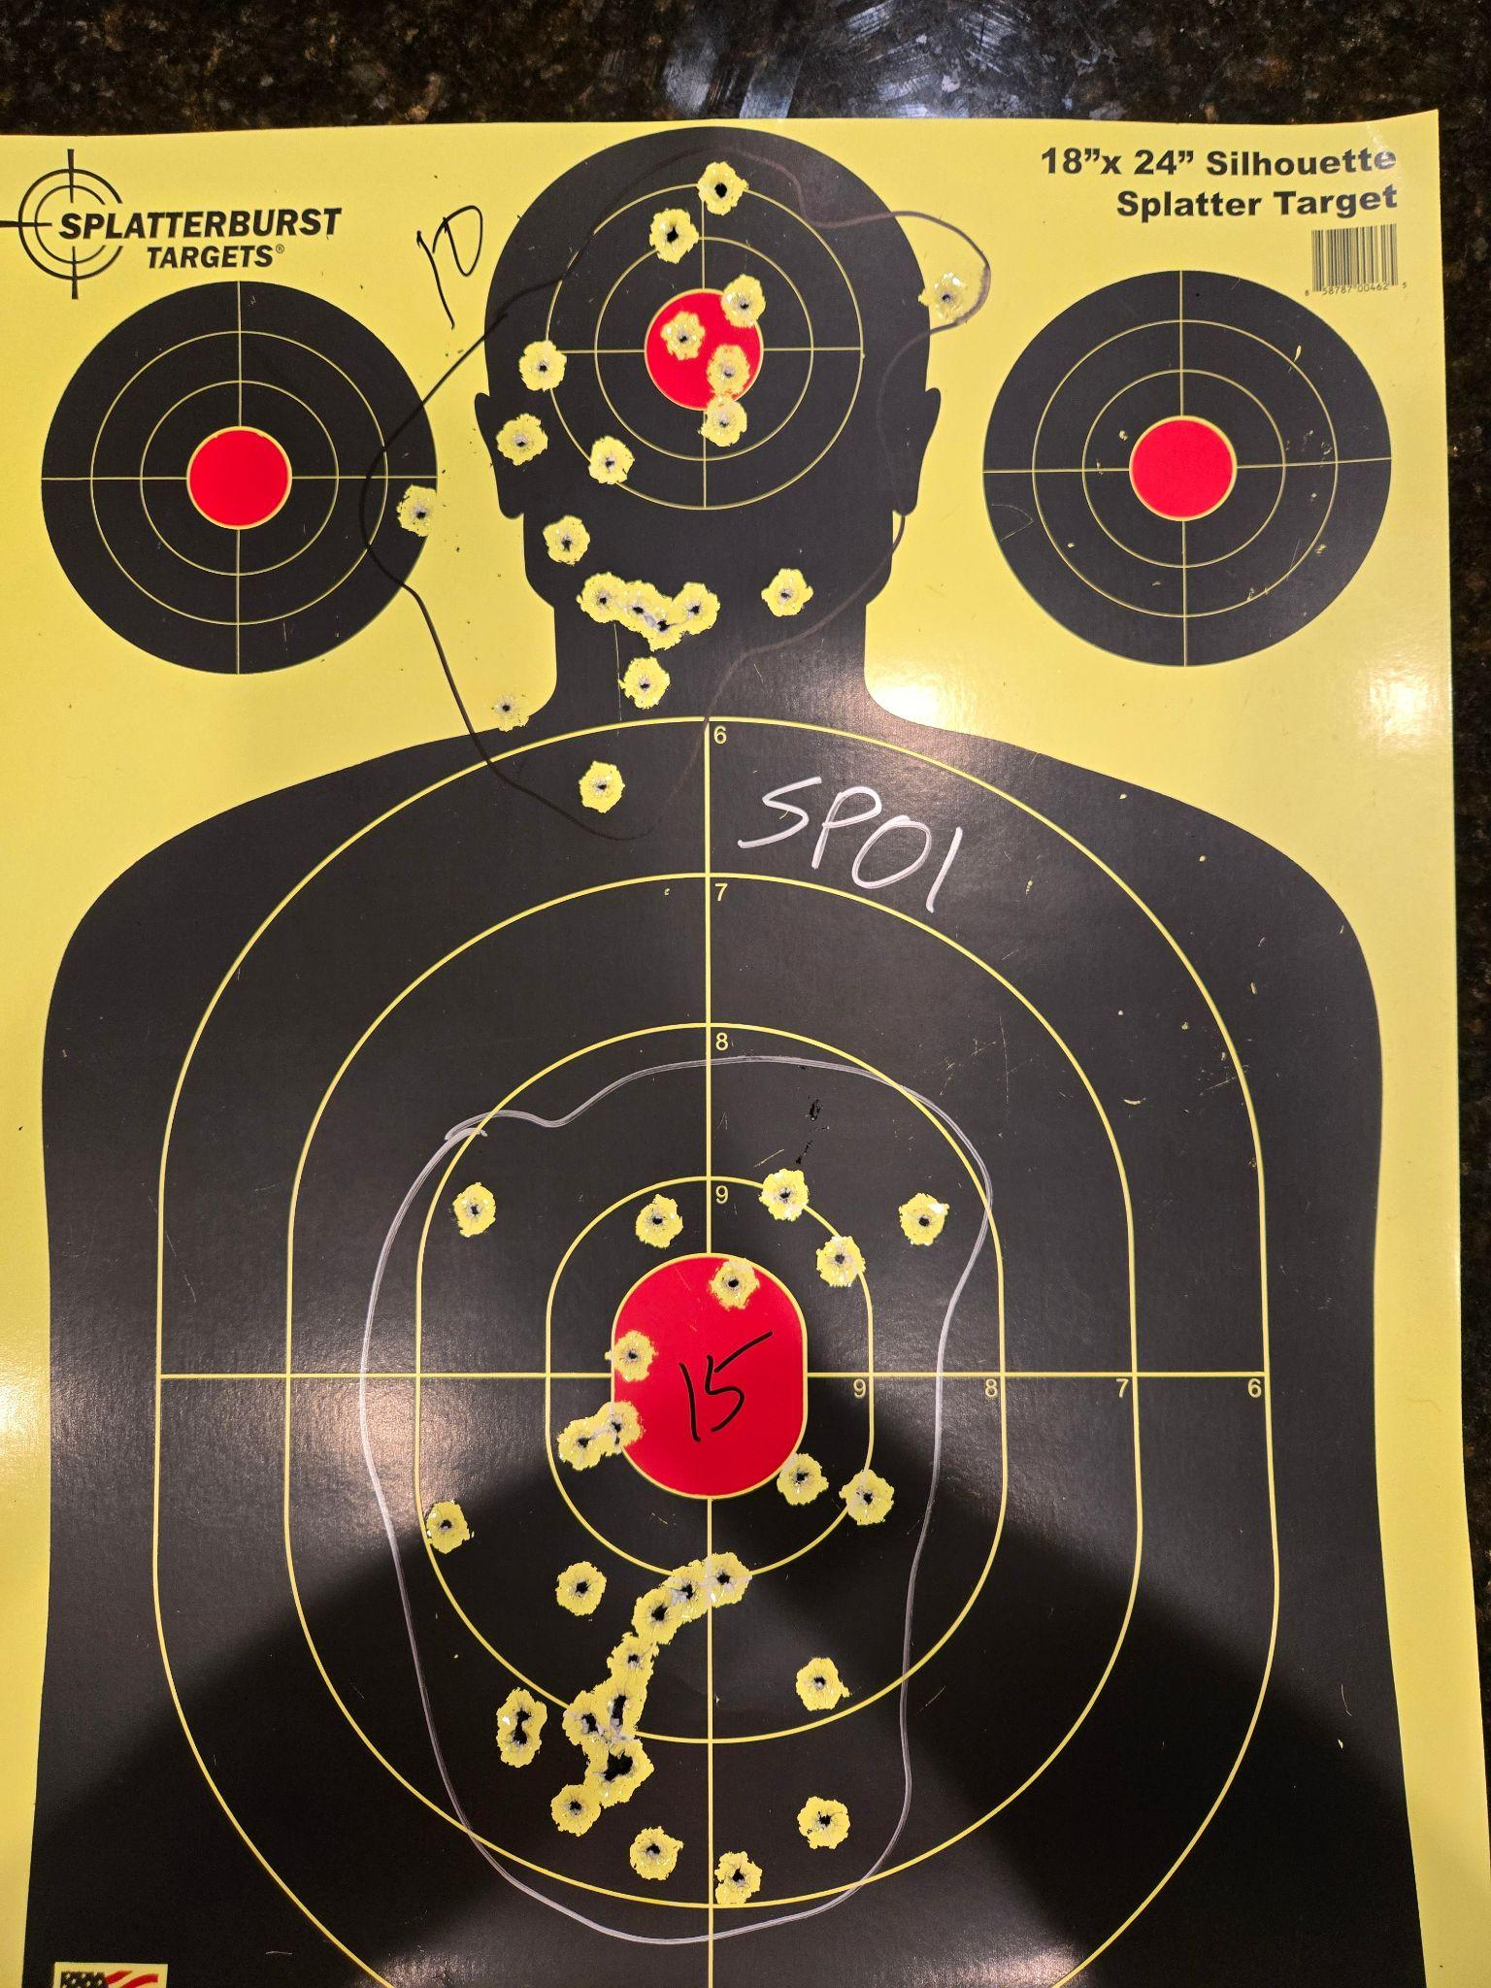
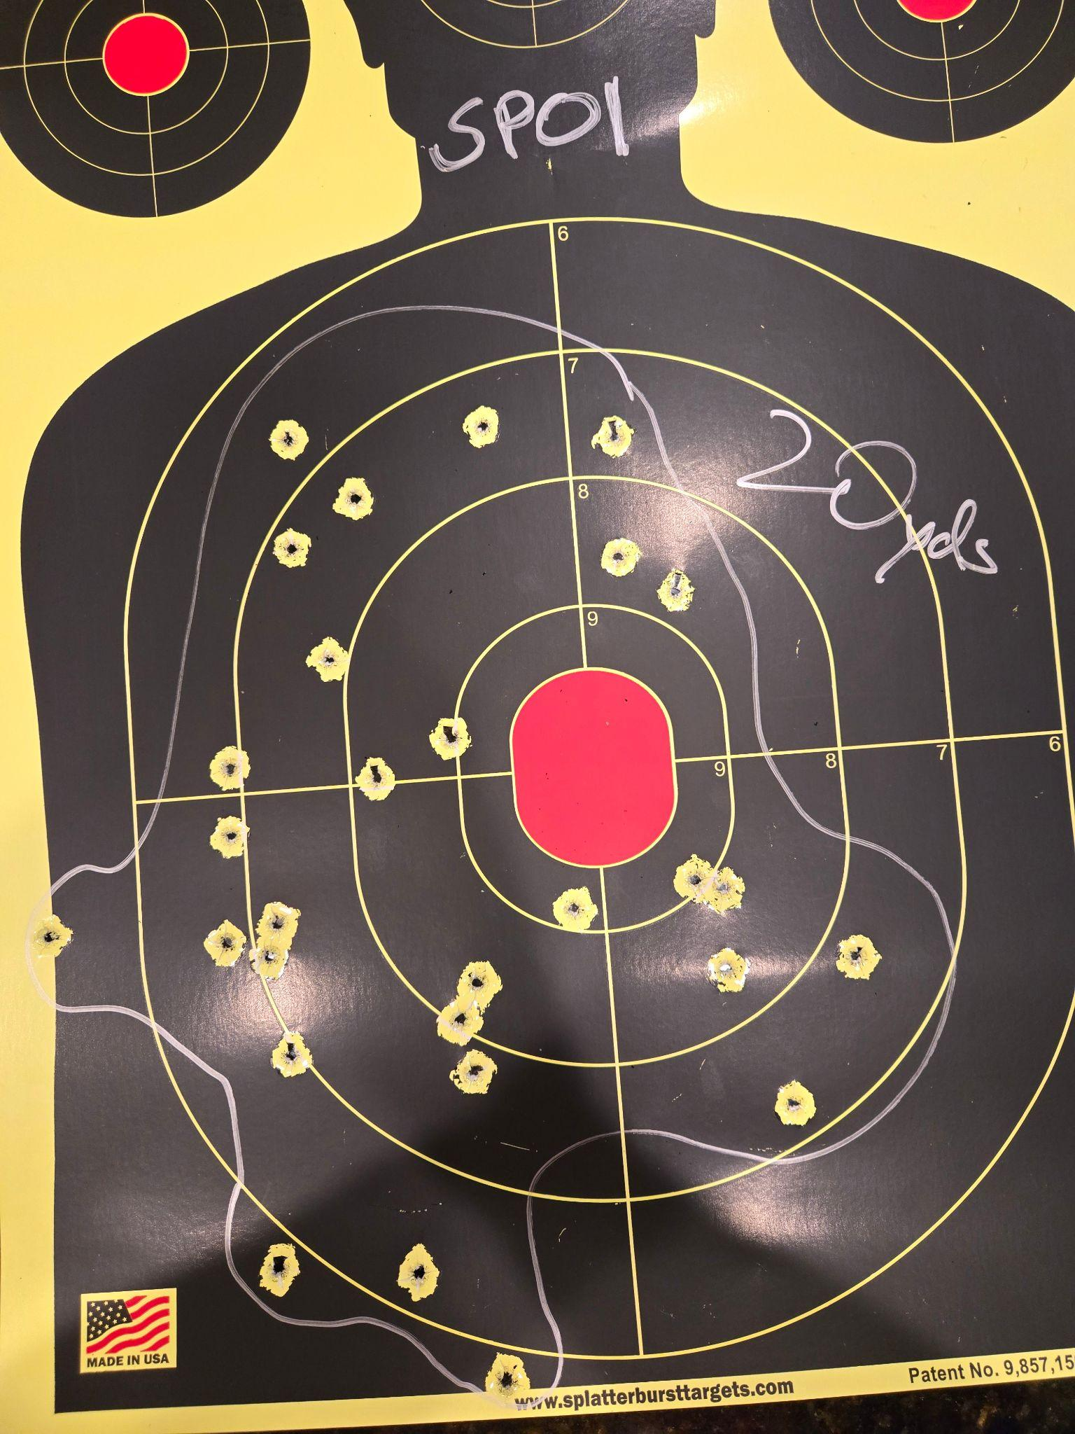
Date: 9/13/25
Guns:
CZ SP01 (90)
Notes:

Slide 18
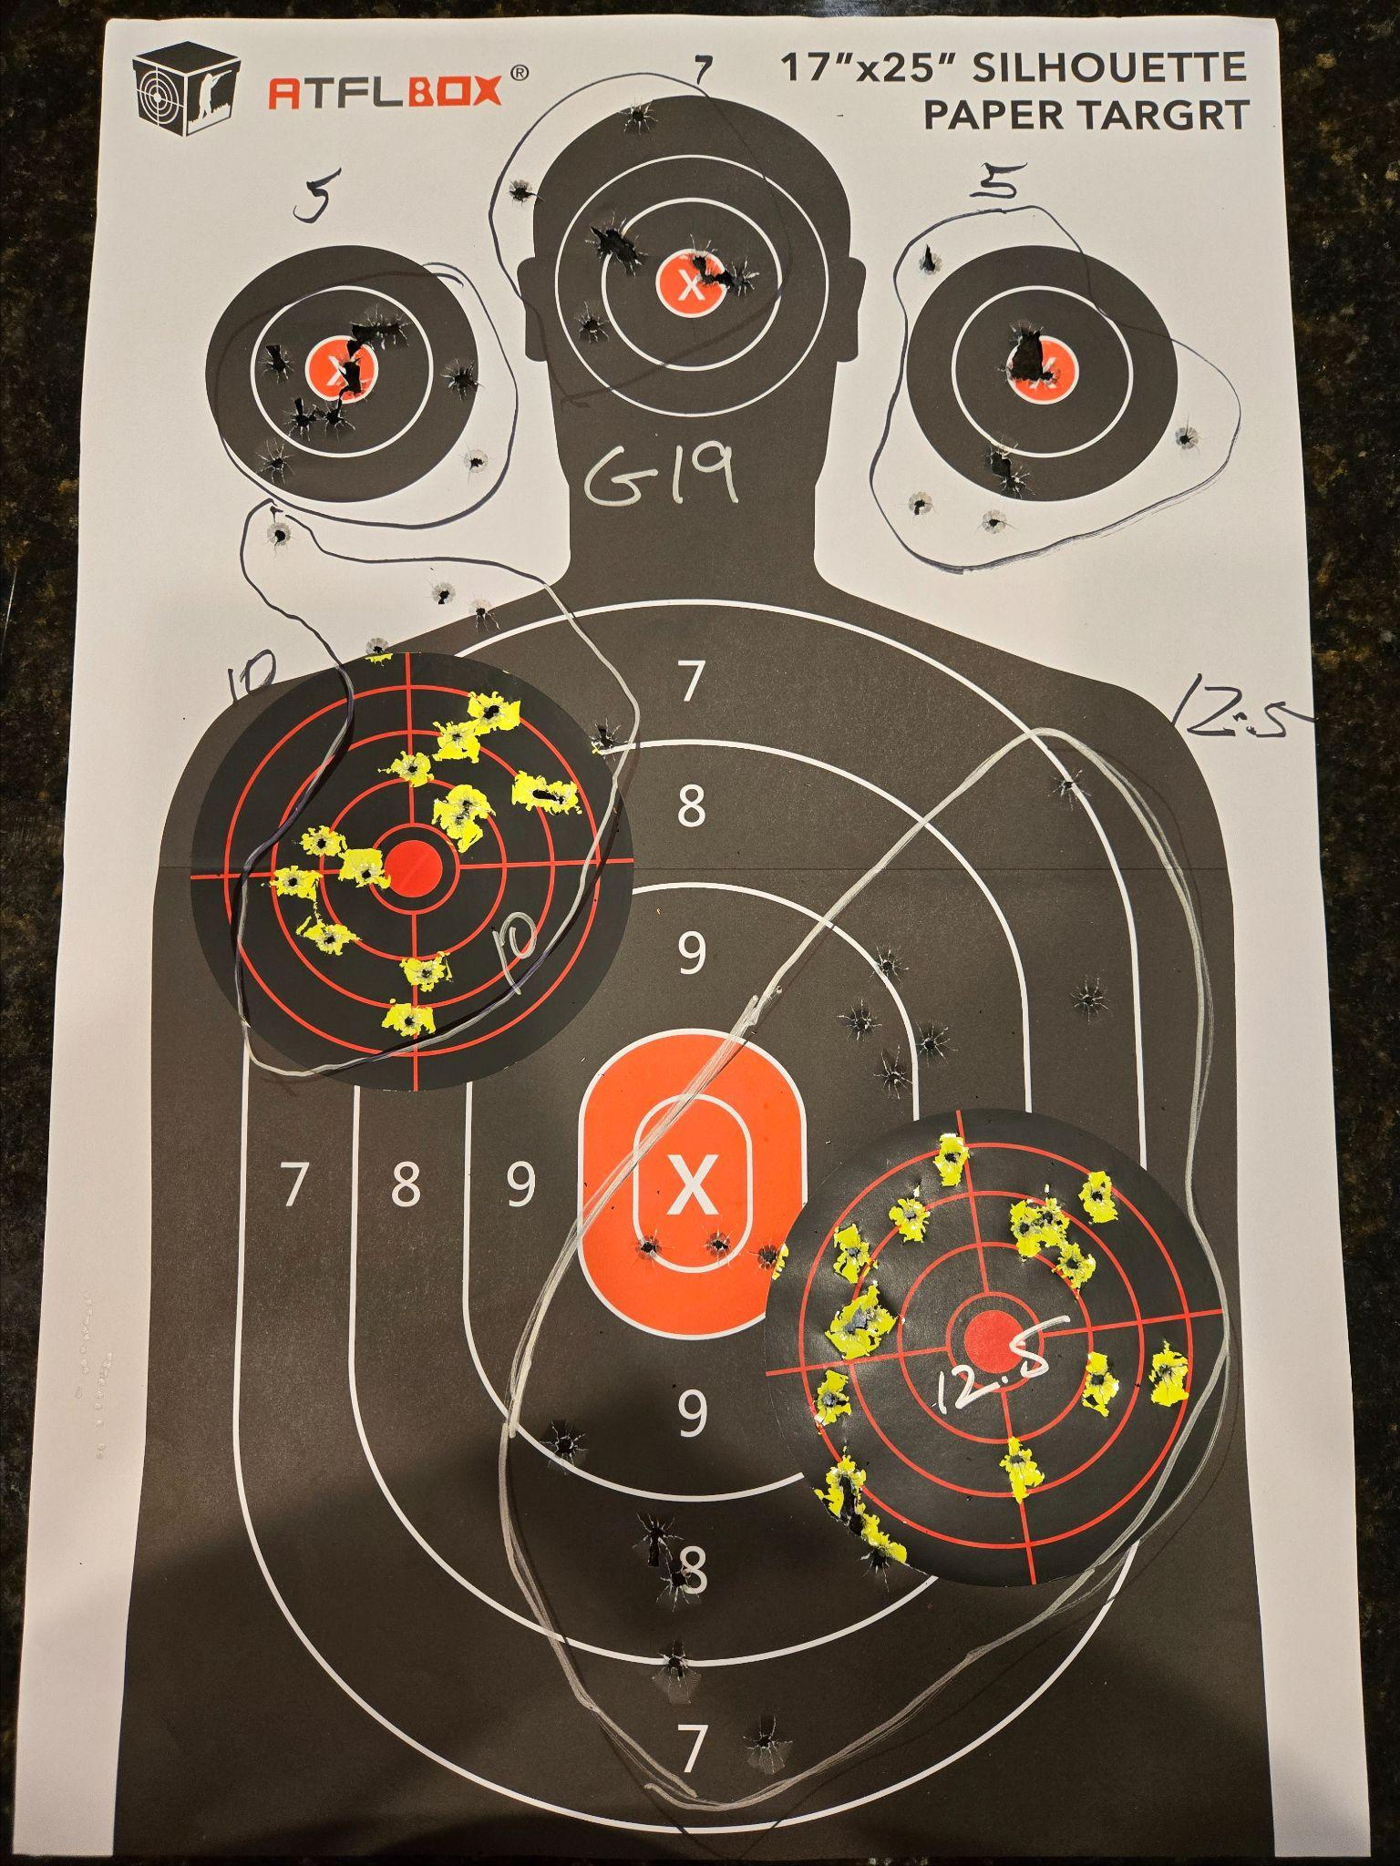
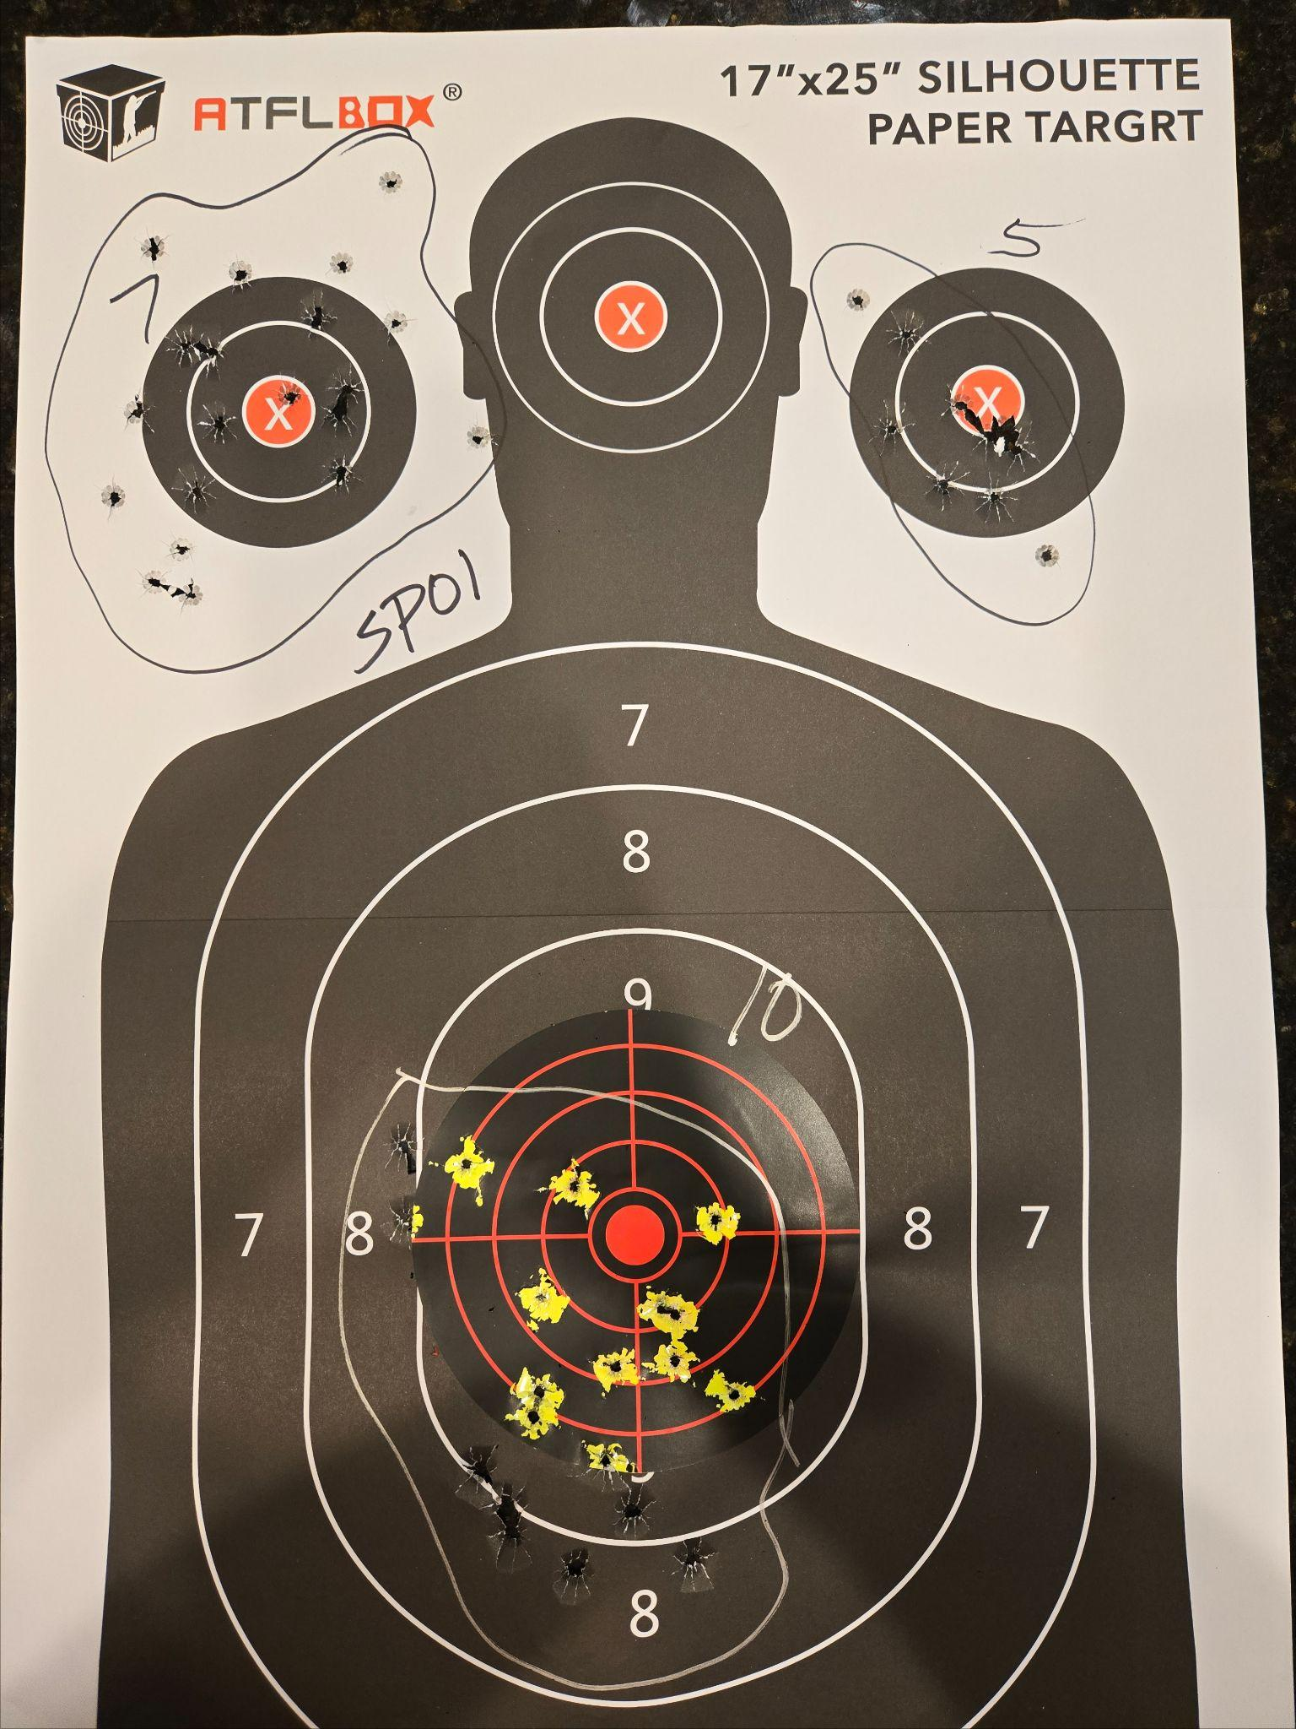
Date: 9/13/25
Guns:
CZ SP01 (40)
G19.3 (80)
Notes:

Slide 19
Date: 8/21/25
Guns:
1911 (78rnds)
HCP (30rnds)
Notes:
Zeroing red dot on HCP. Gave up, returned.
1911 -
39@7.5yds
39@10yds
AWFUL.
Too embarrassed to post pics.

Slide 20
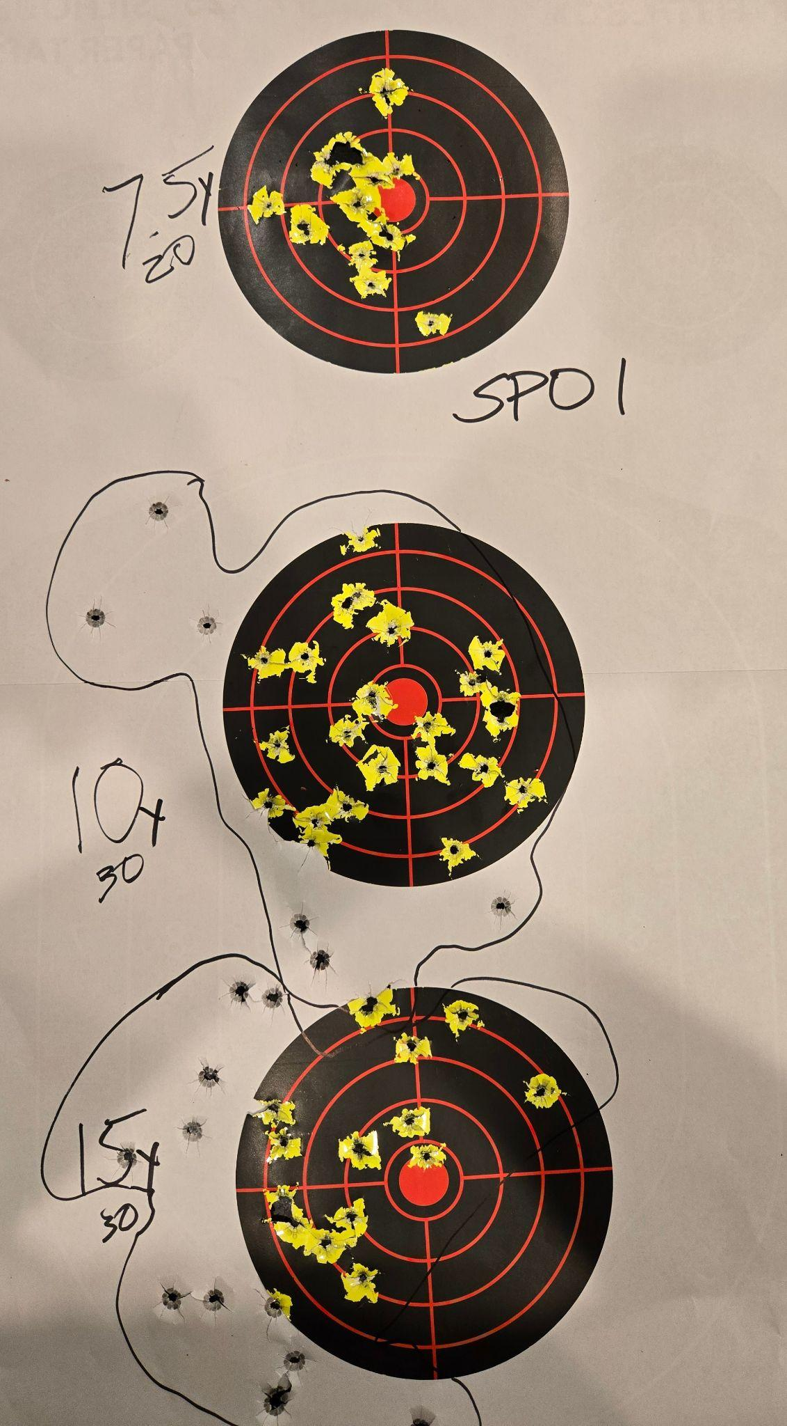
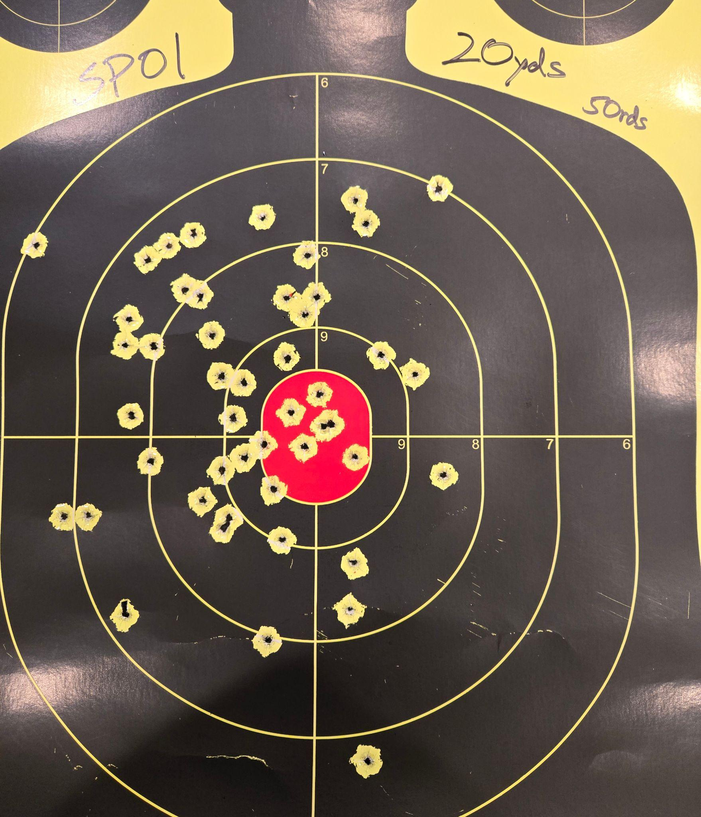
Date: 8/6/25
Guns:
CZ SP01
Notes:
20@7.5yds
30@10yds
30@15yds
50@17.5yds
Not unhappy with the 17.5 yds

Slide 21
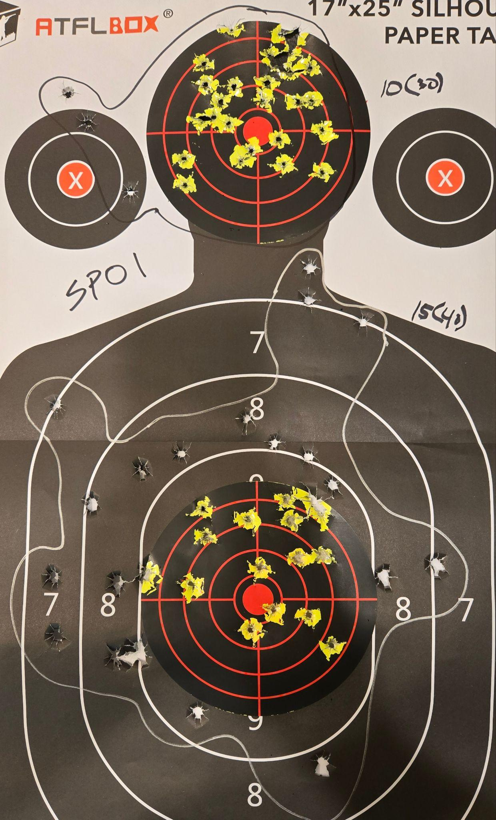
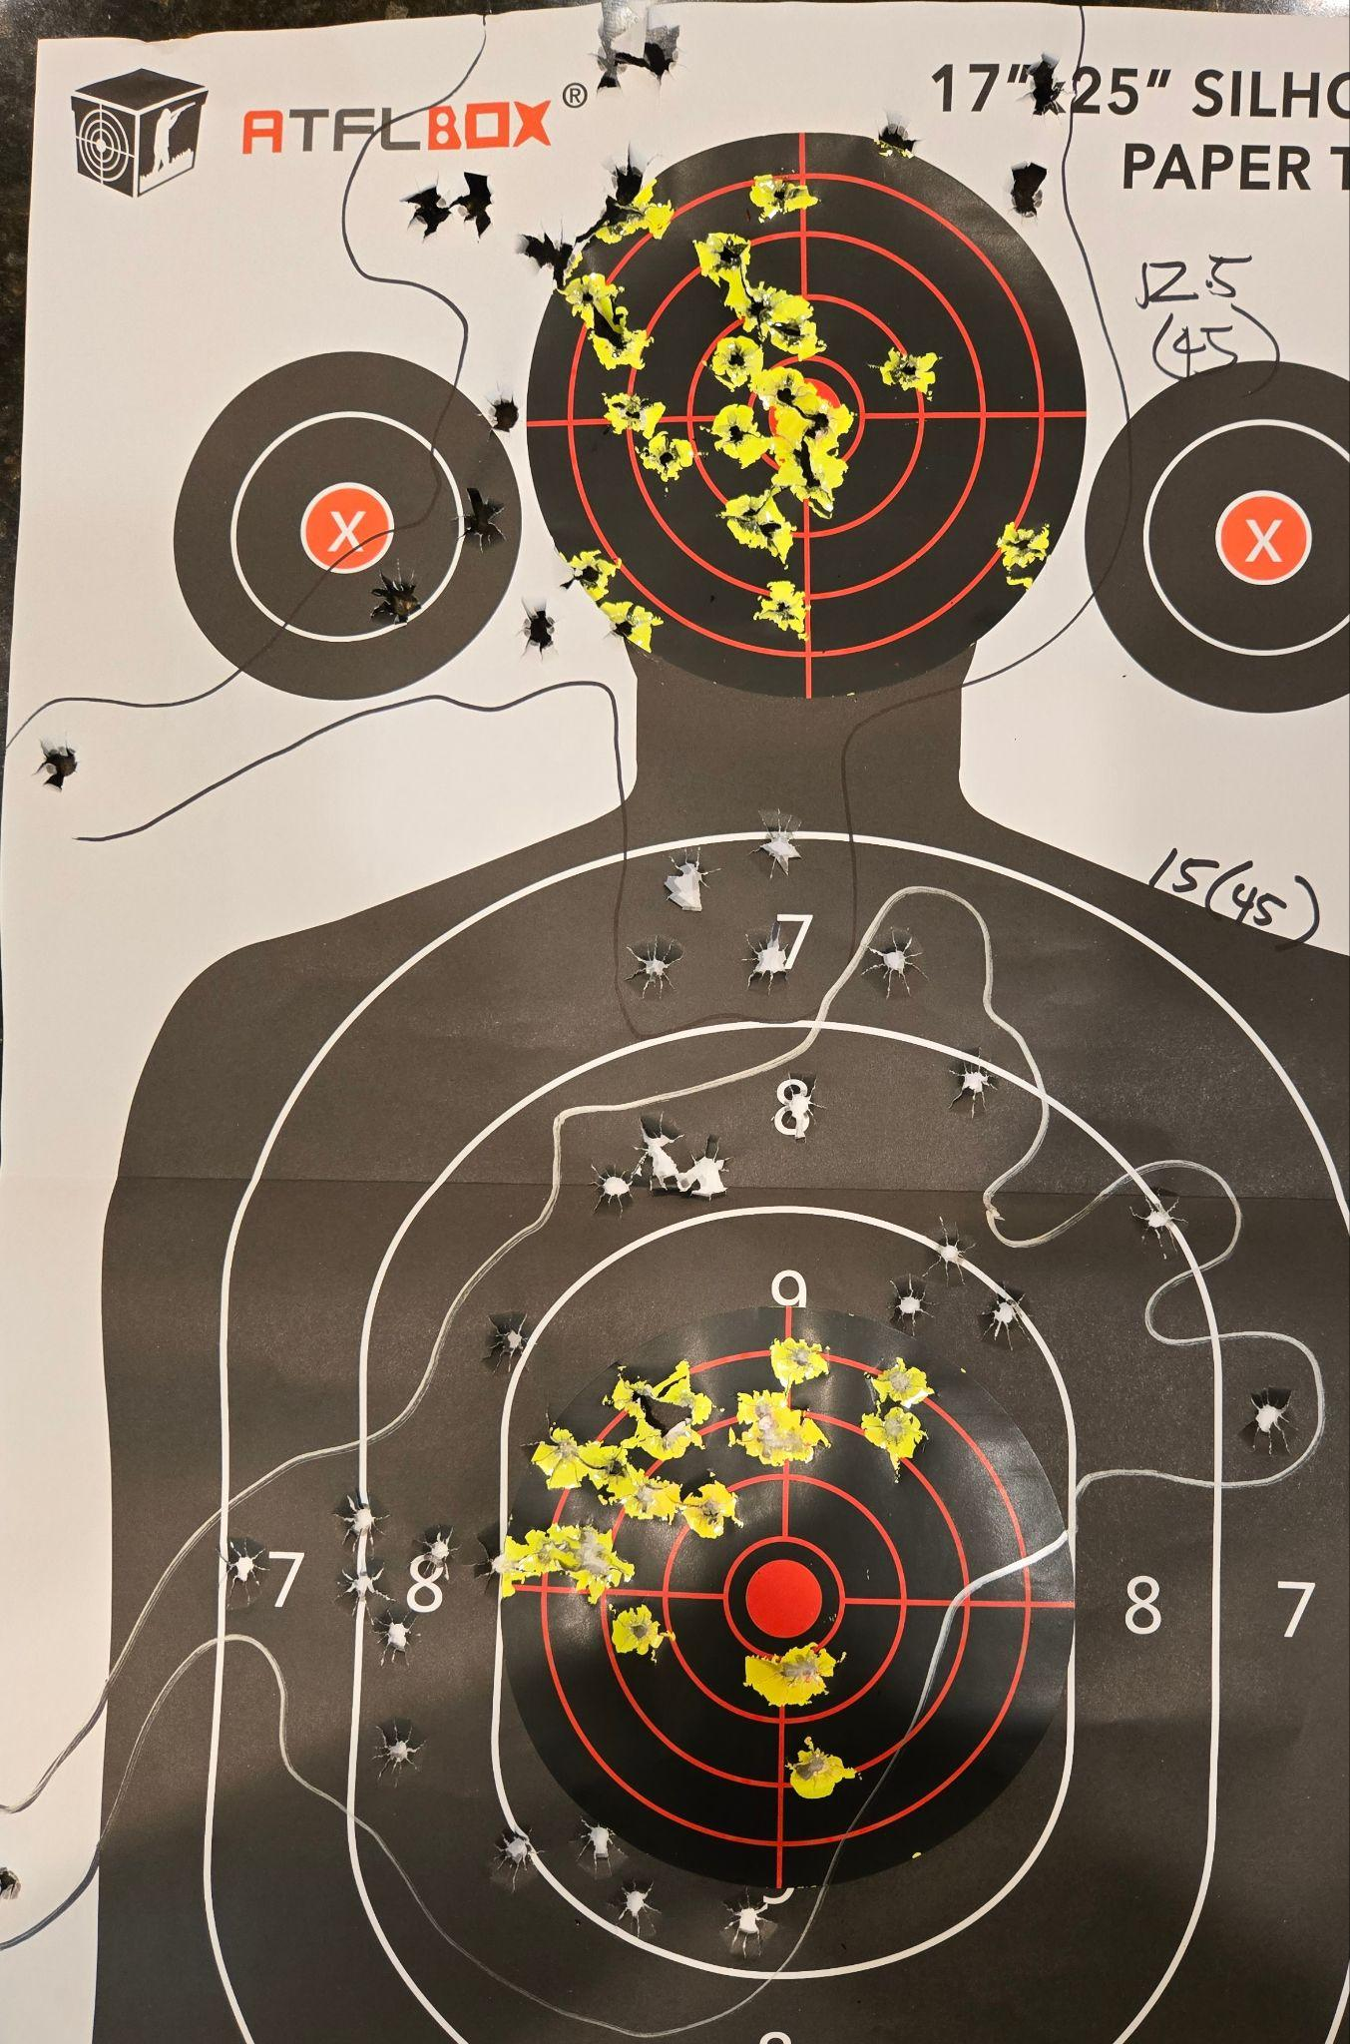
Date: 8/6/25
Guns:
CZ SP01
Notes:
40 rounds warm up 5 & 7yds (no picture)
30 @ 10yds
40 @ 15 yds
45 @ 12.5yds
45 @ 15yds

Slide 22
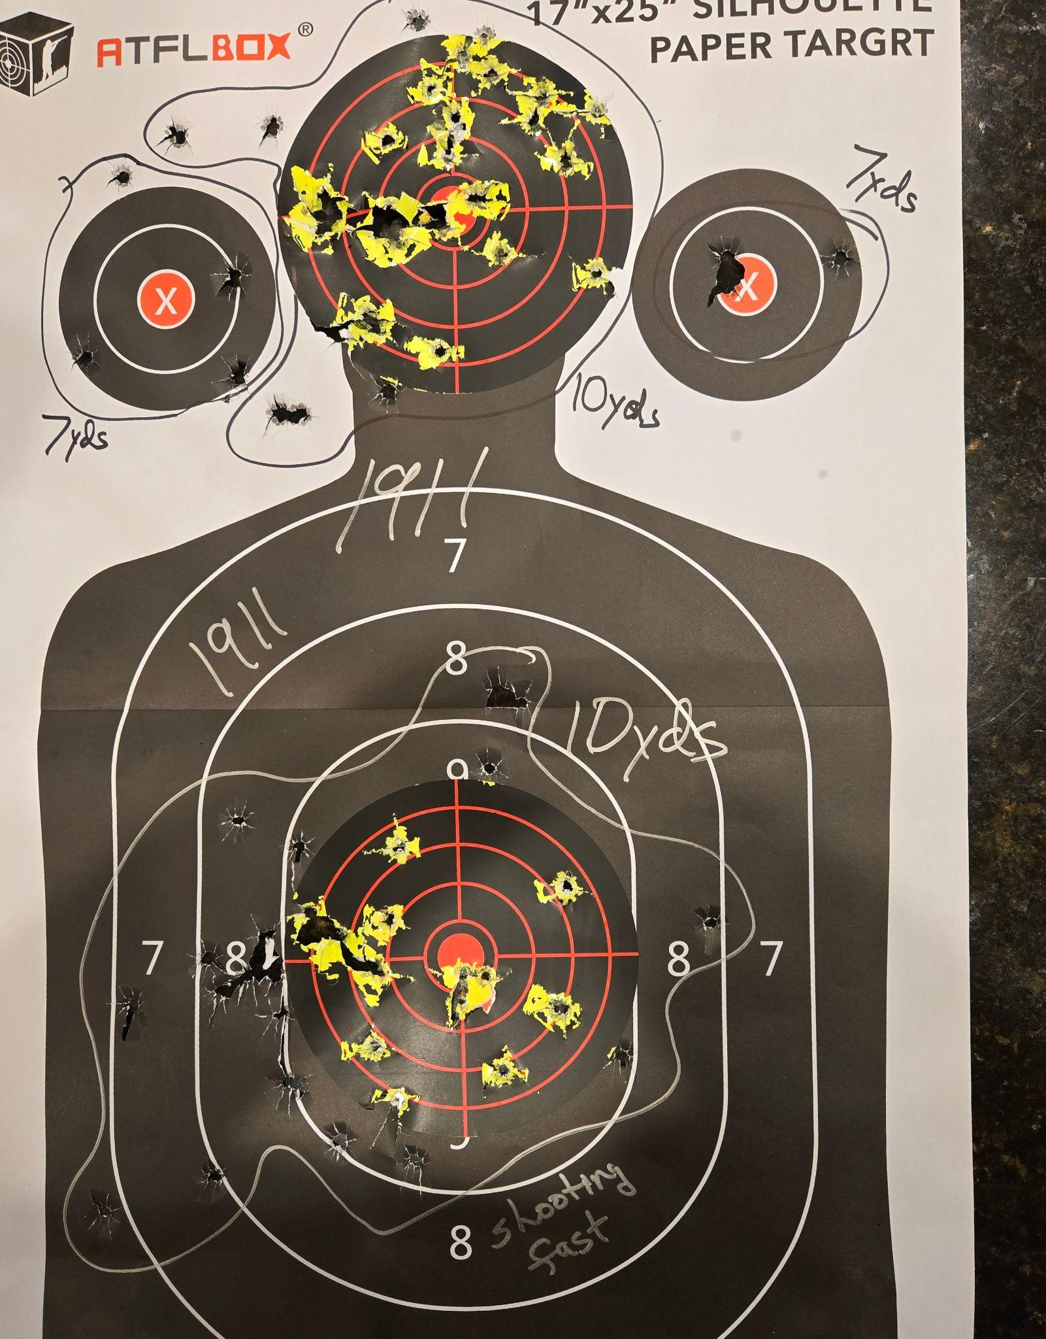
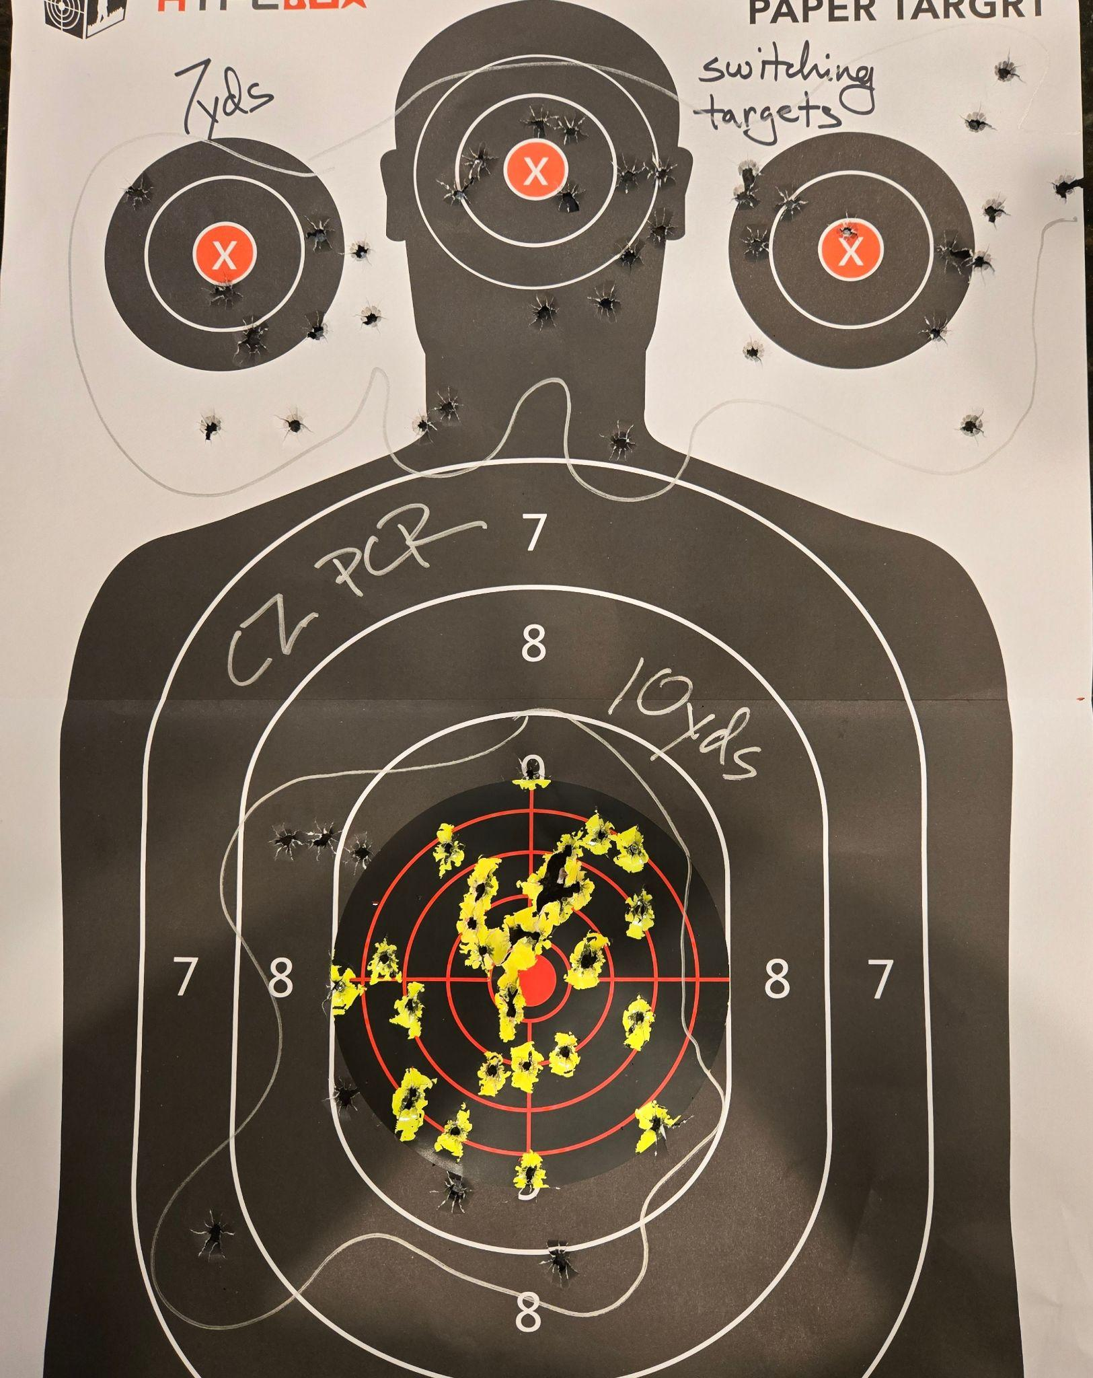
Date: 7/22/25
Guns:
1911
CZ PCR
Notes:
78 rounds 1911
80 rounds PCR
meh

Slide 23
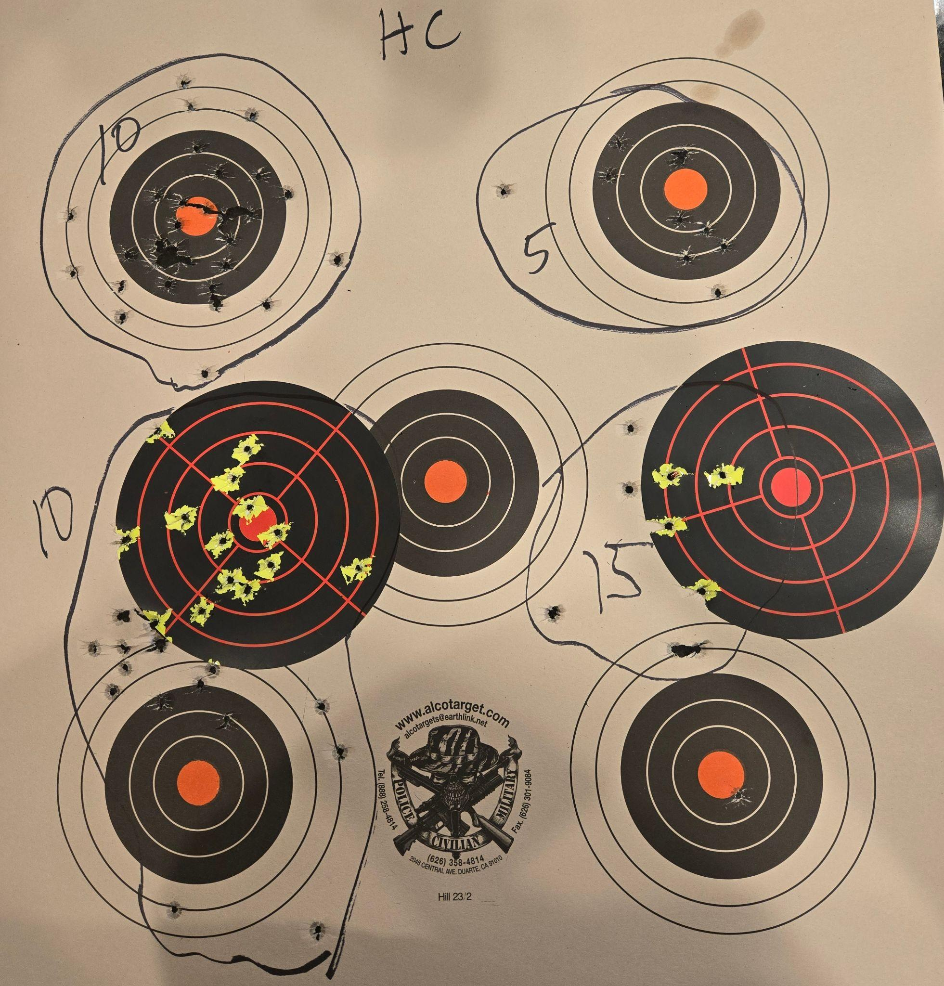
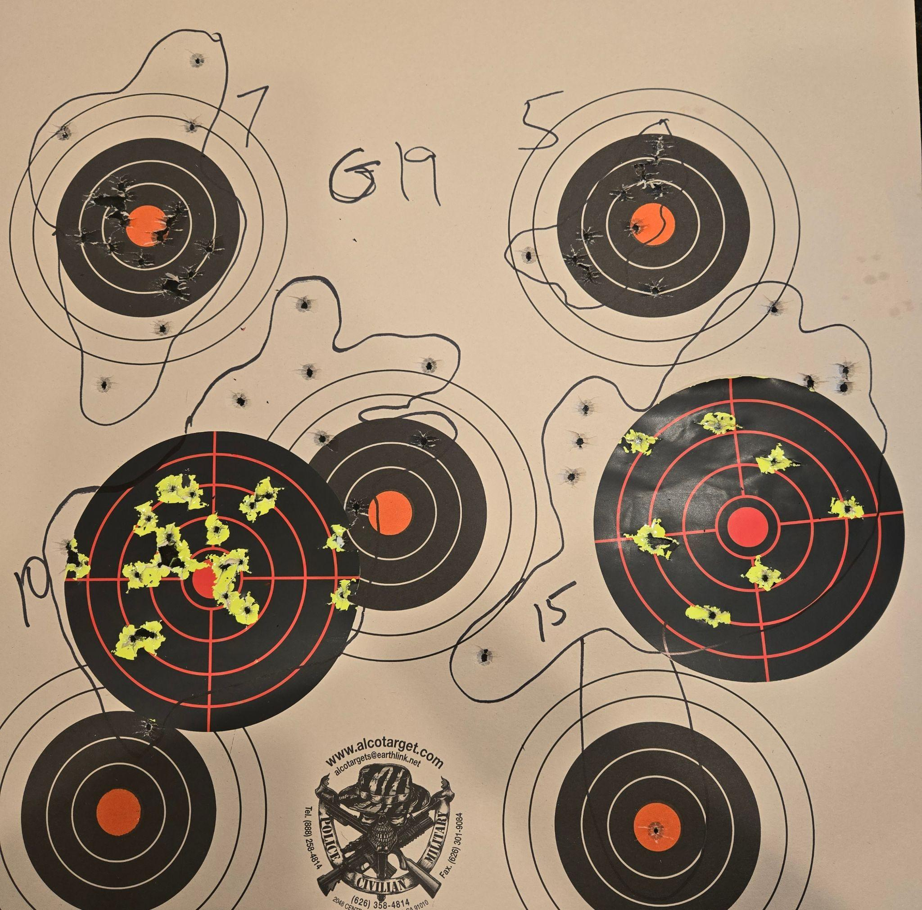
Date: 7/15/25
Guns:
HC Pro
Glock 19
Notes:
80 rounds each
HCP: 30 on 10
10 on 15
G19: 20 on 10
20 on 15
(so, despite appearances, G19 much more accurate at 10 than HCP)

Slide 24
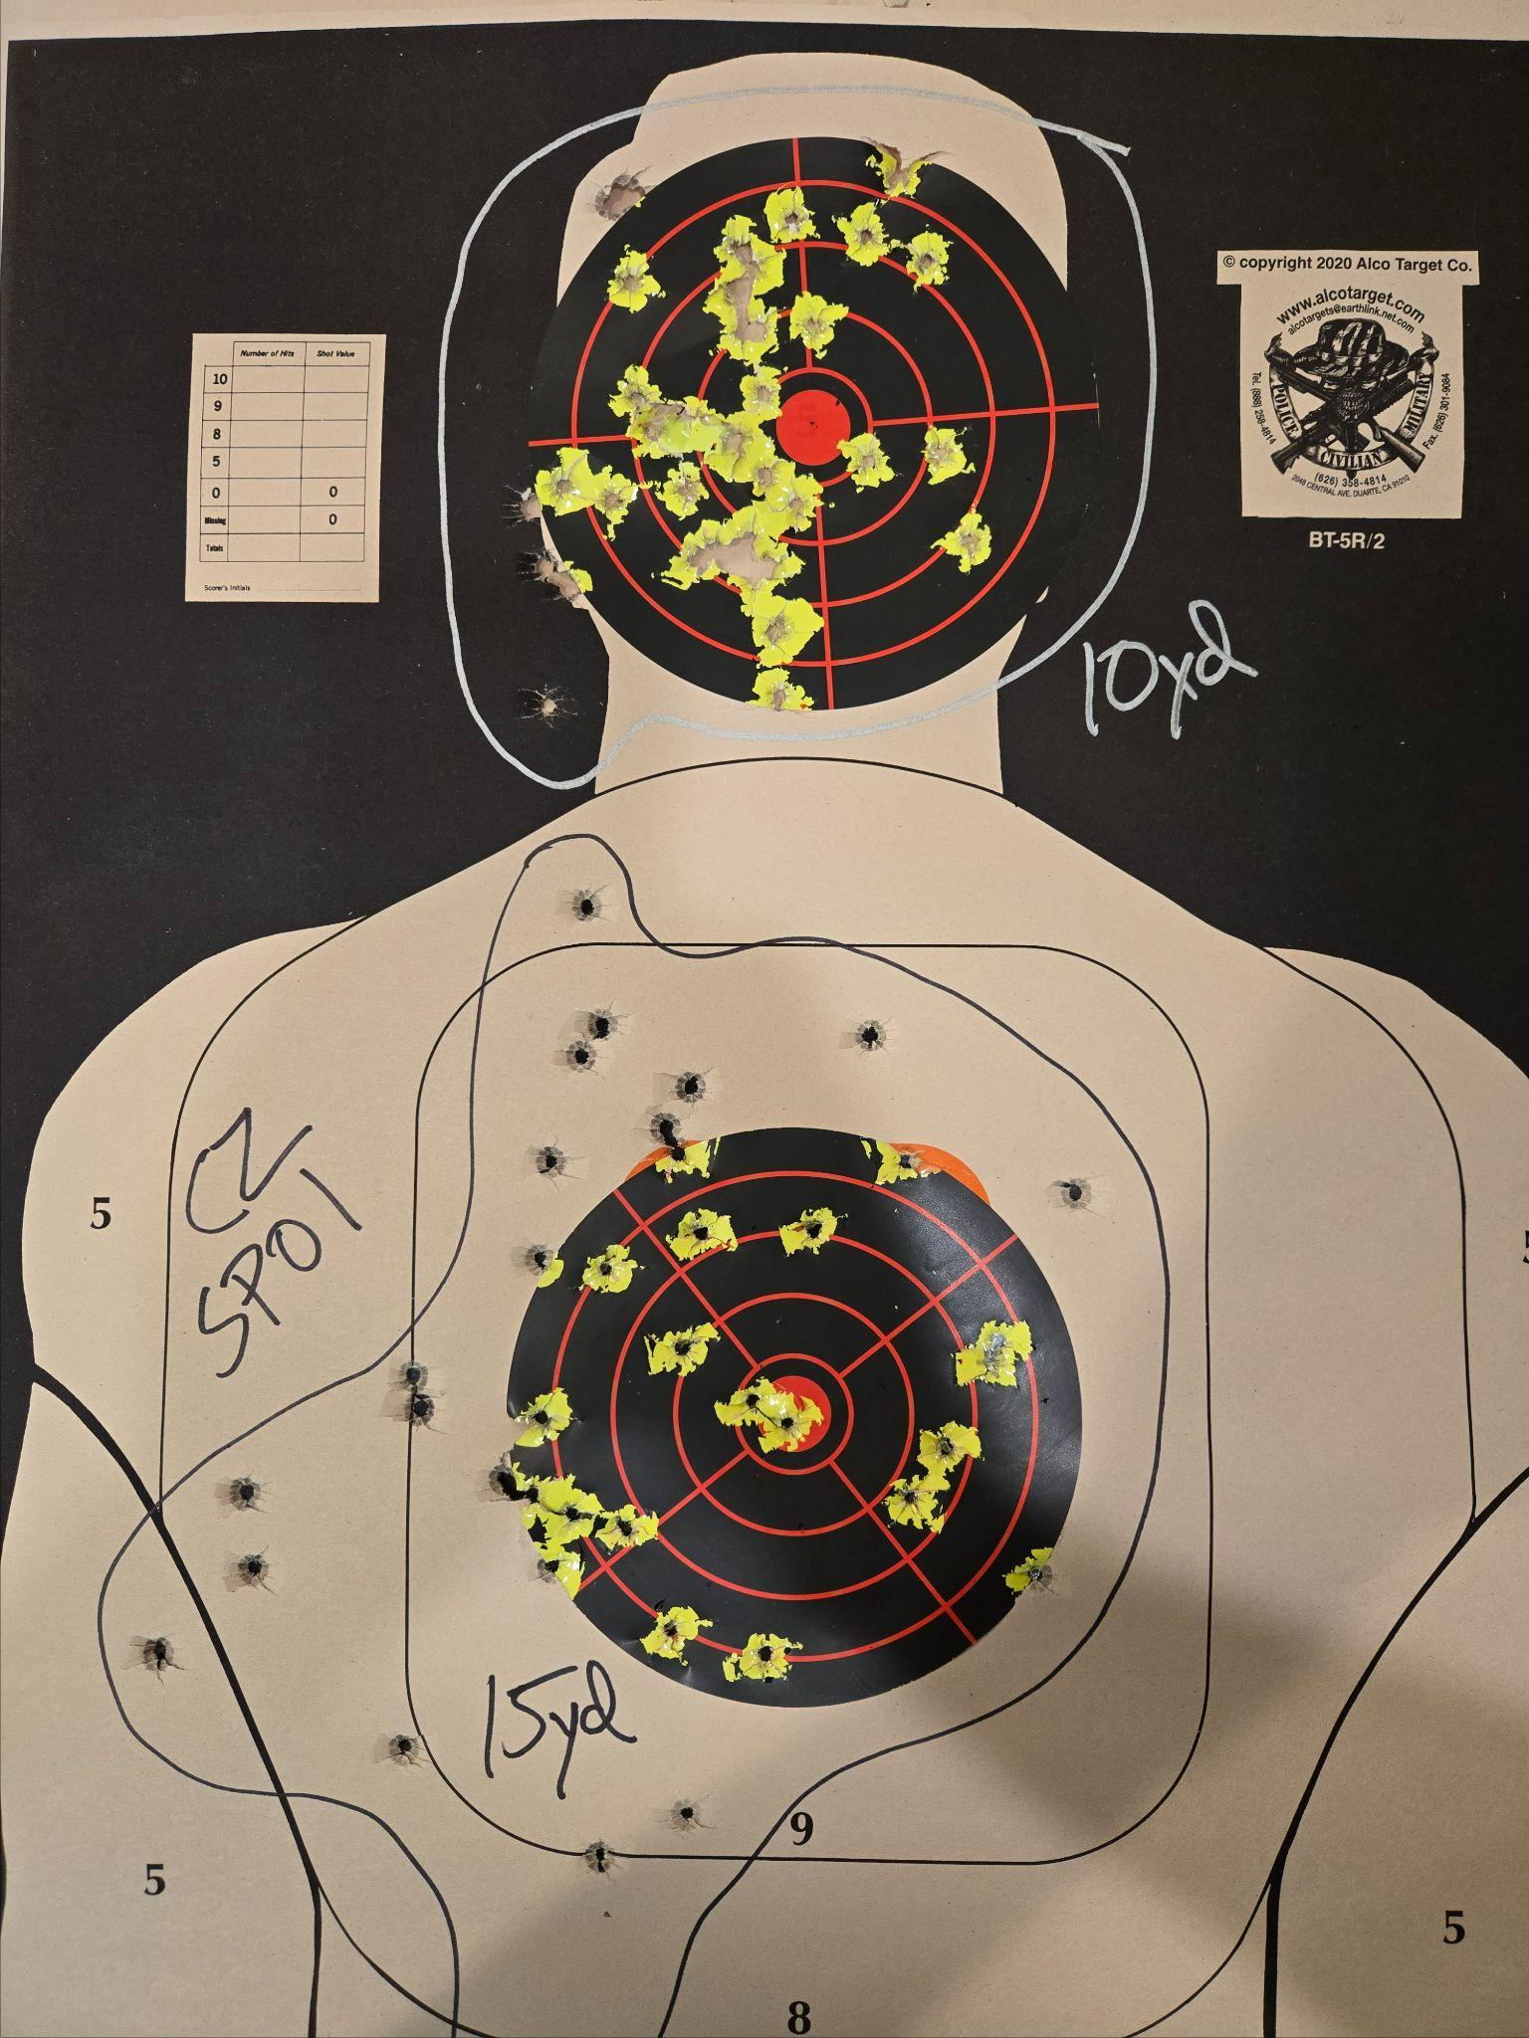
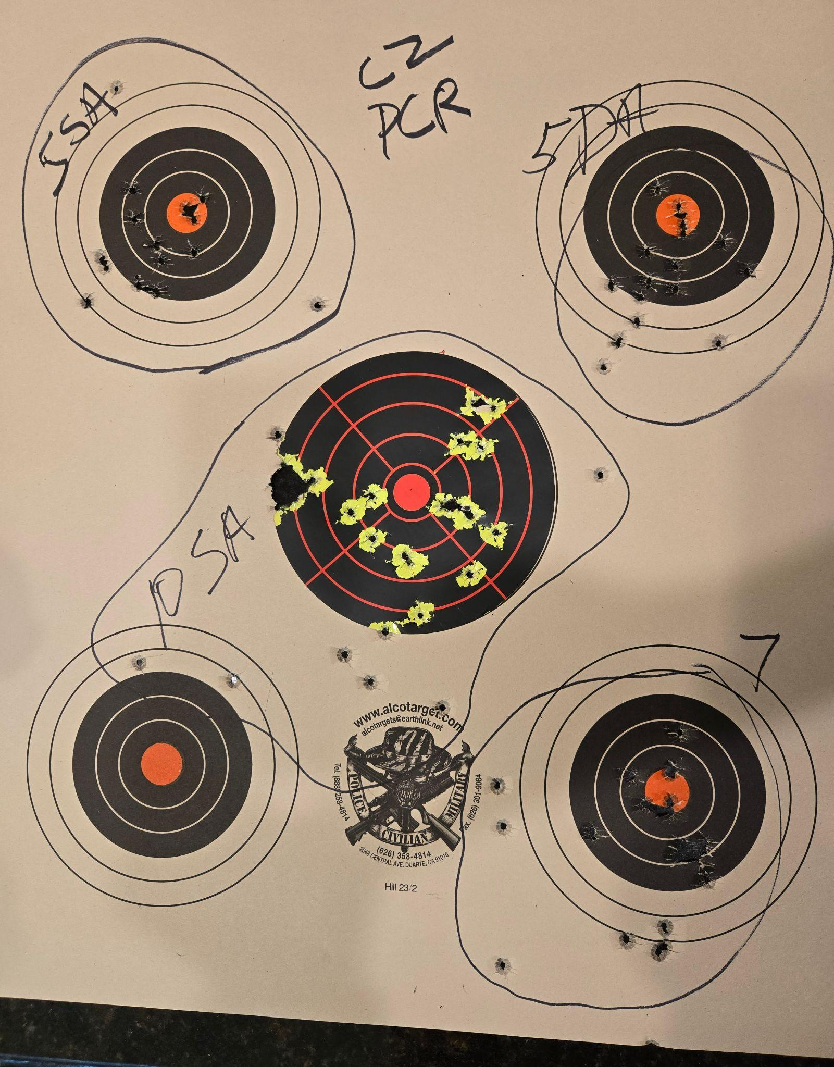
Date: 7/8/25
Guns:
CZ SP01
CZ 75 PCR
Notes:
80 rounds each
90% of the 15yd hits on target were from last 2 (of 4) mags

Slide 25
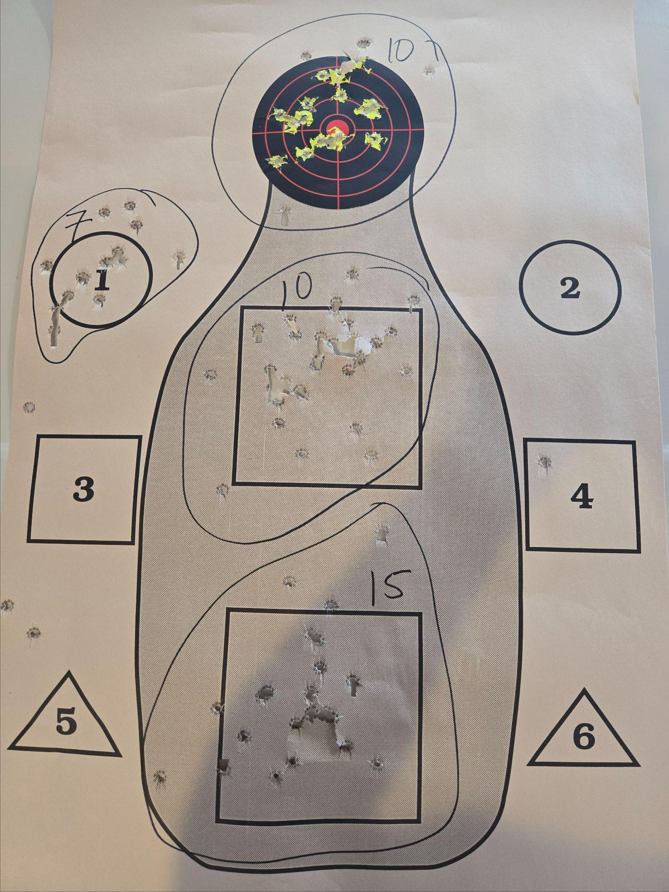
Date: 7/1/25
Guns:
Kimber 1911 TLE II .45
Notes:
FTF solved by smacking slide forward

Slide 26
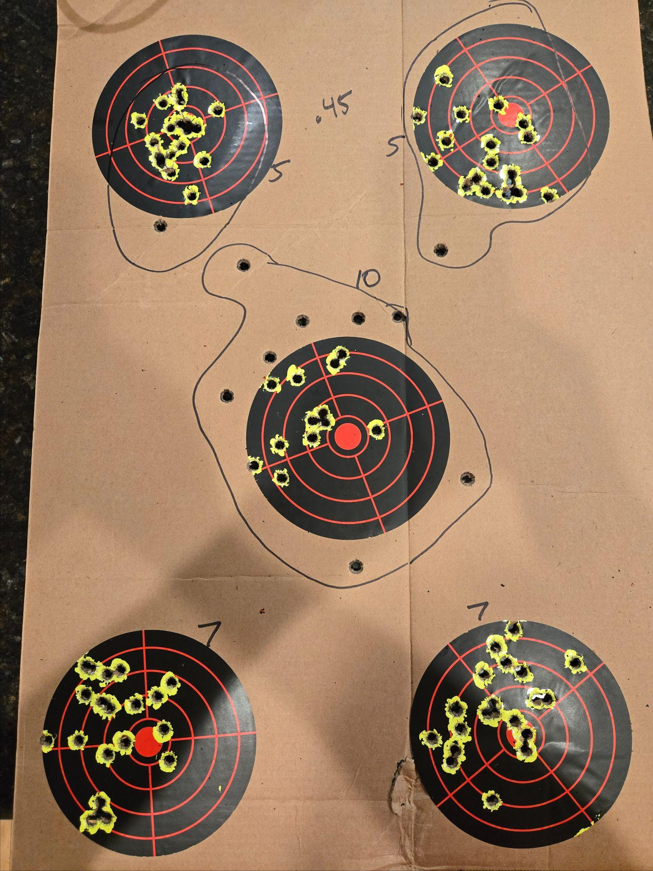
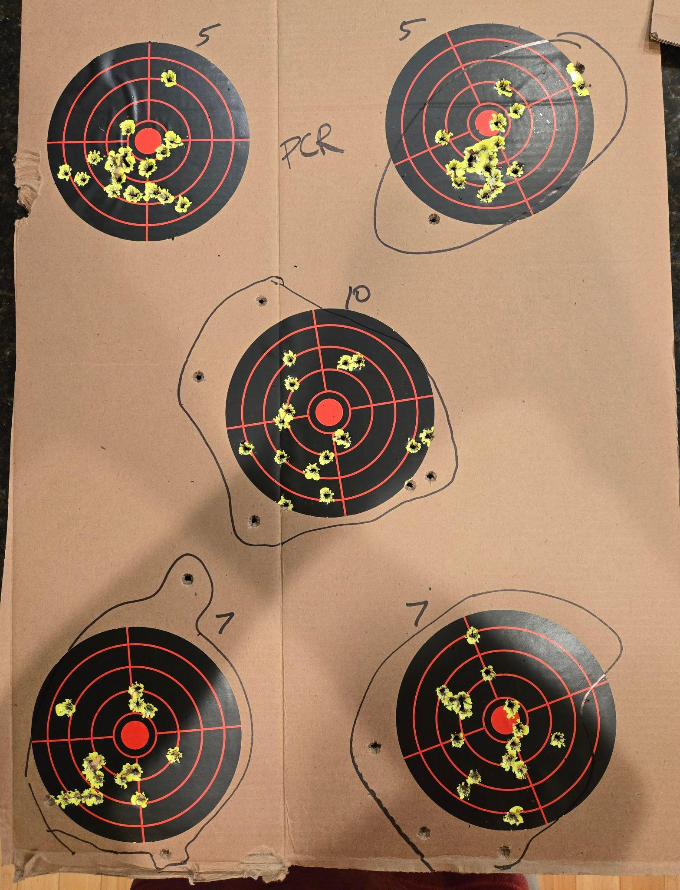
Date: 5/12/25
Guns:
Kimber 1911 TLE II .45
CZ 75D PCR
Notes:
FTF with one of the extended 1911 mags
Trigger finger hurt on the PCR

Slide 27
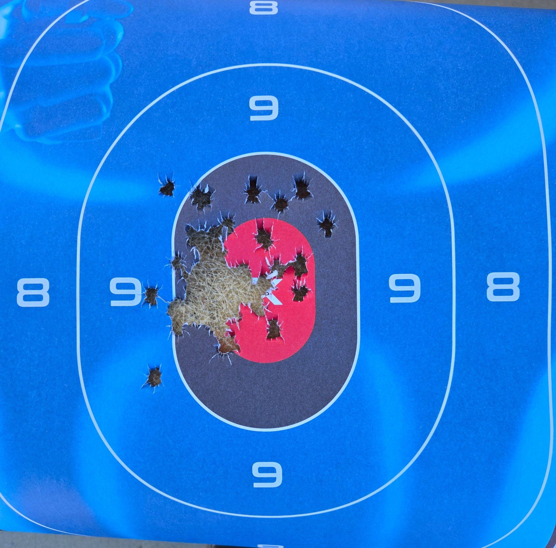
Date: 4/6/25
Guns:
G19, HCP
Notes:
CCW certification
10 shots each from 3, 5, 7 yards, both pistols
(I passed)

Slide 28
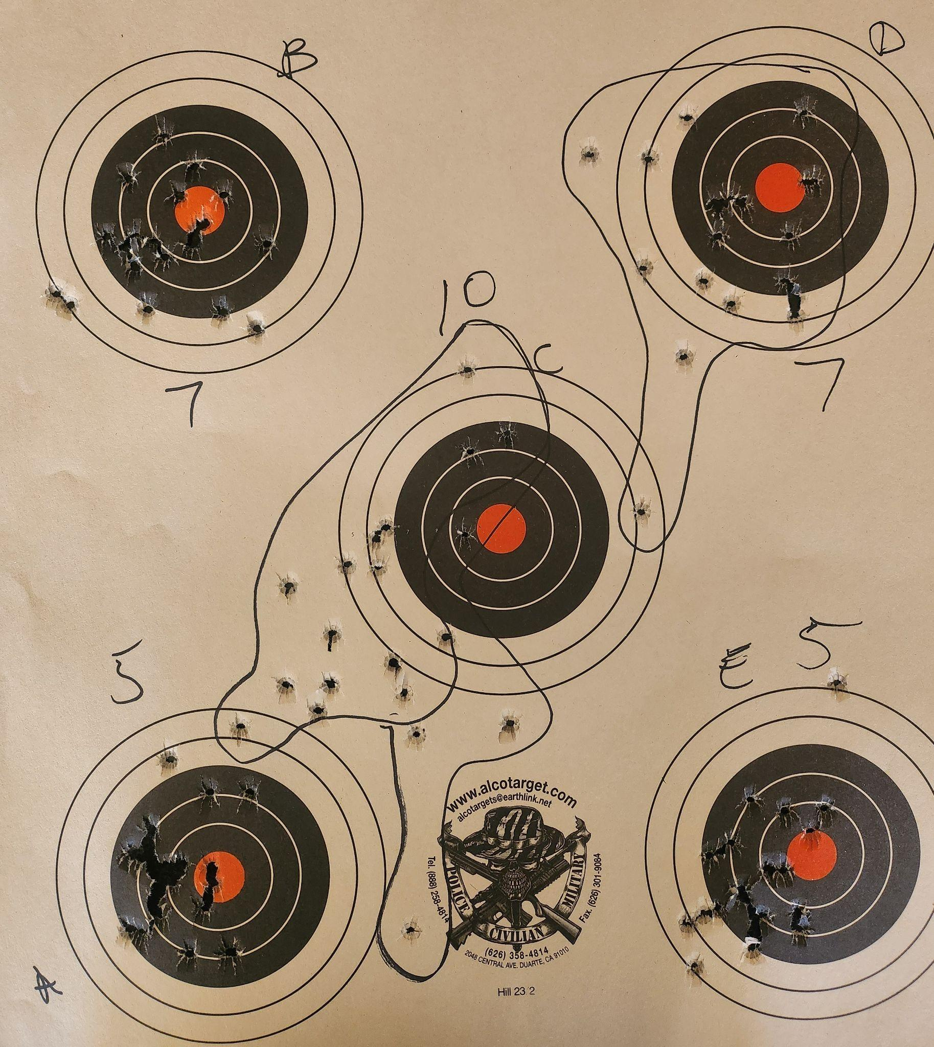
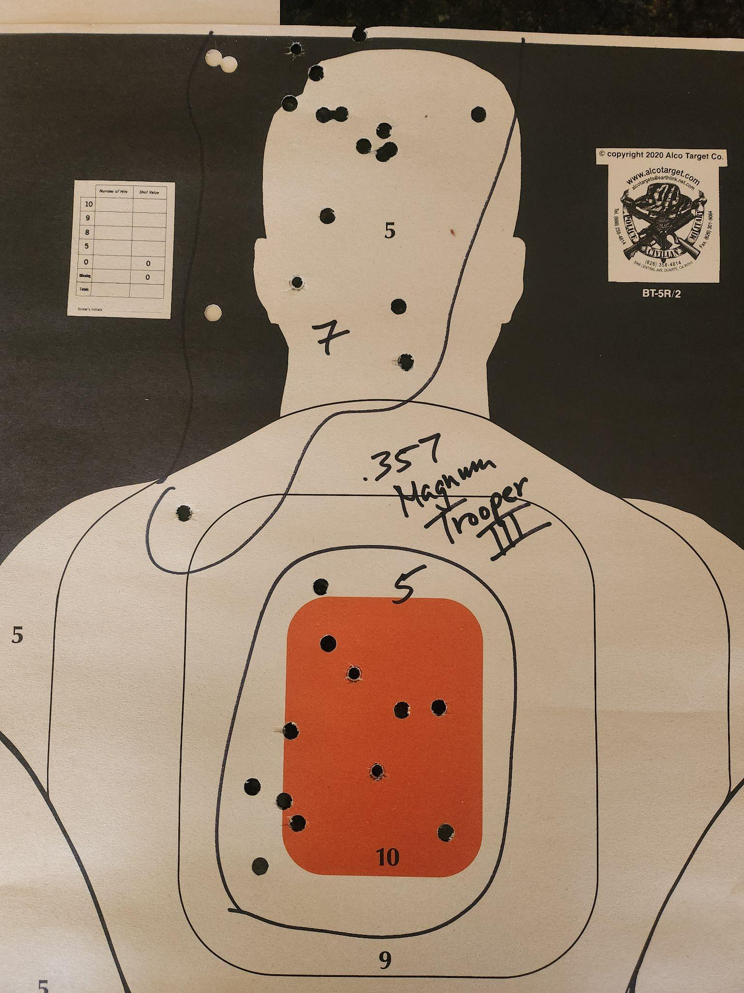
Date: 3/18/25
Guns:
G19, .357 Mag
Notes:
G19

Slide 29
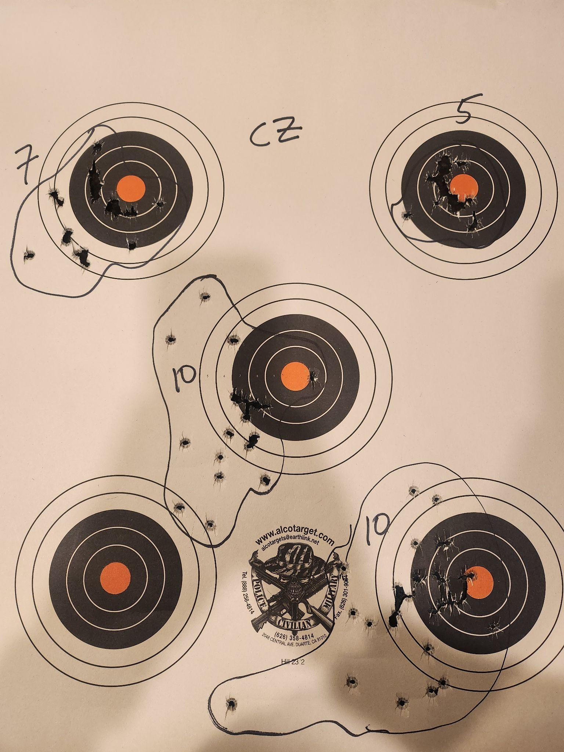
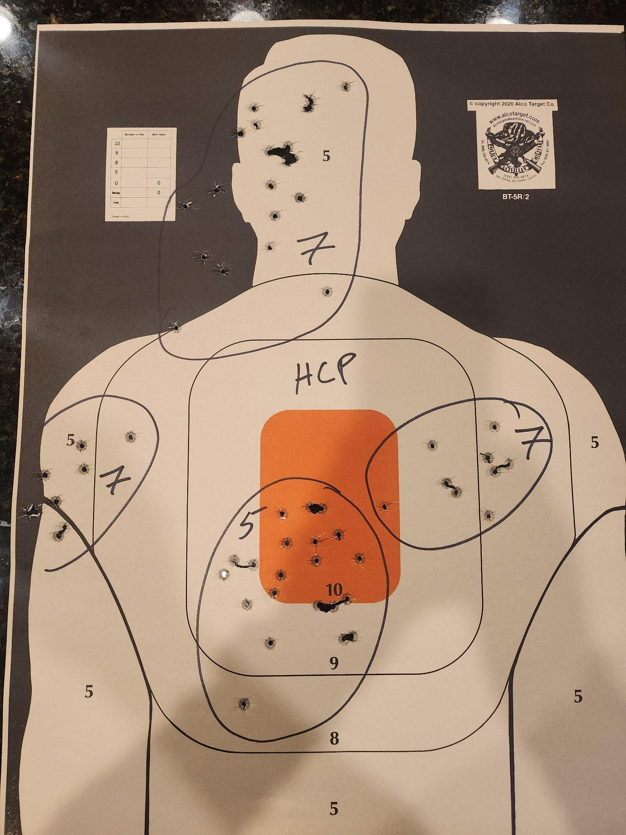
Date: 3/11/25
Guns:
CZ, HCP
Notes:

Slide 30
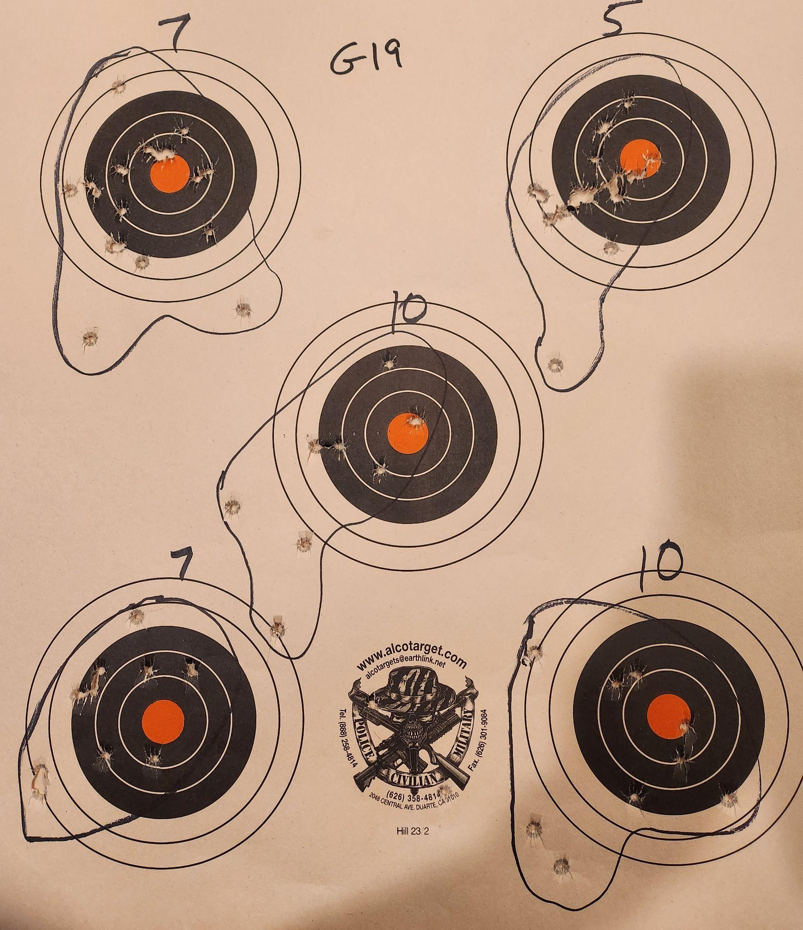
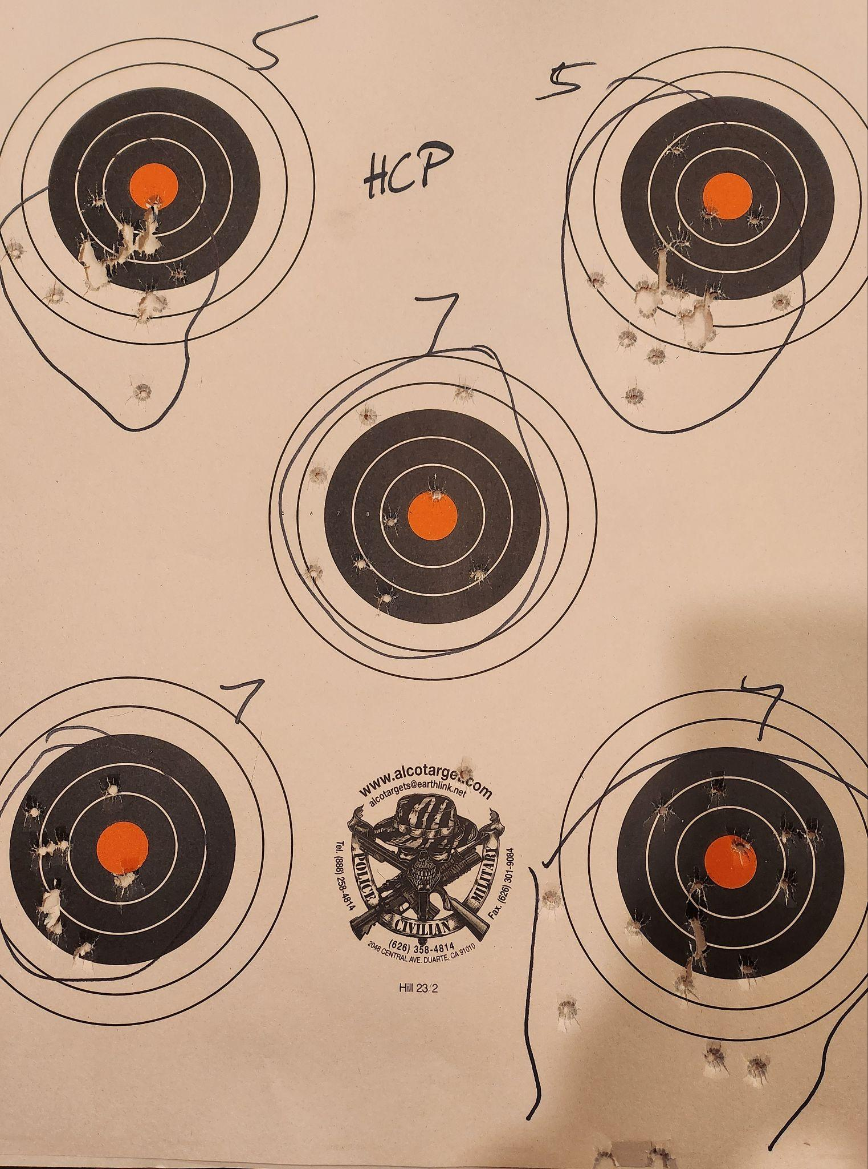
Date: 1/31/25
Guns:
G19, HCP
Notes:
Breathing makes a huge difference
HCP: Difference from 7A to 7B - right thumb stiff and off slide
Same on 7C, but not same results
C
B
A

Slide 31
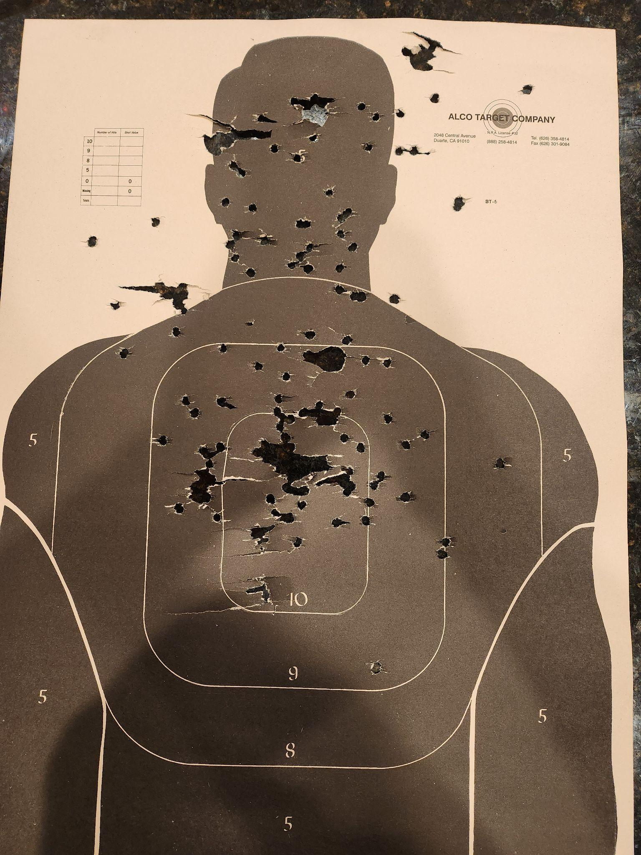
Date: 1/10/25
Guns:
Mossberg 590
Notes:
Painful

Slide 32
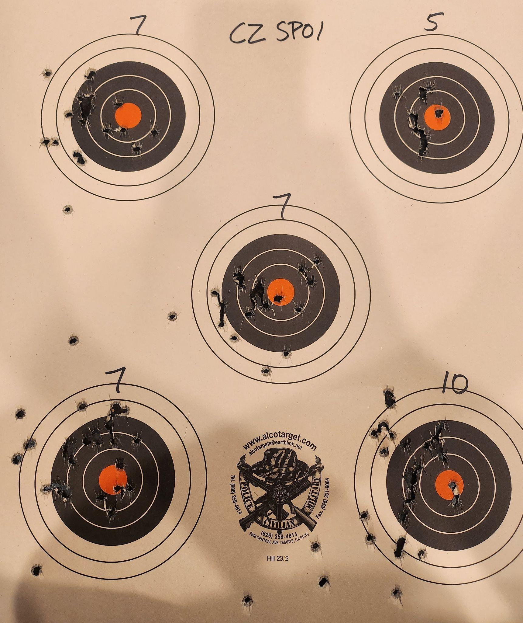
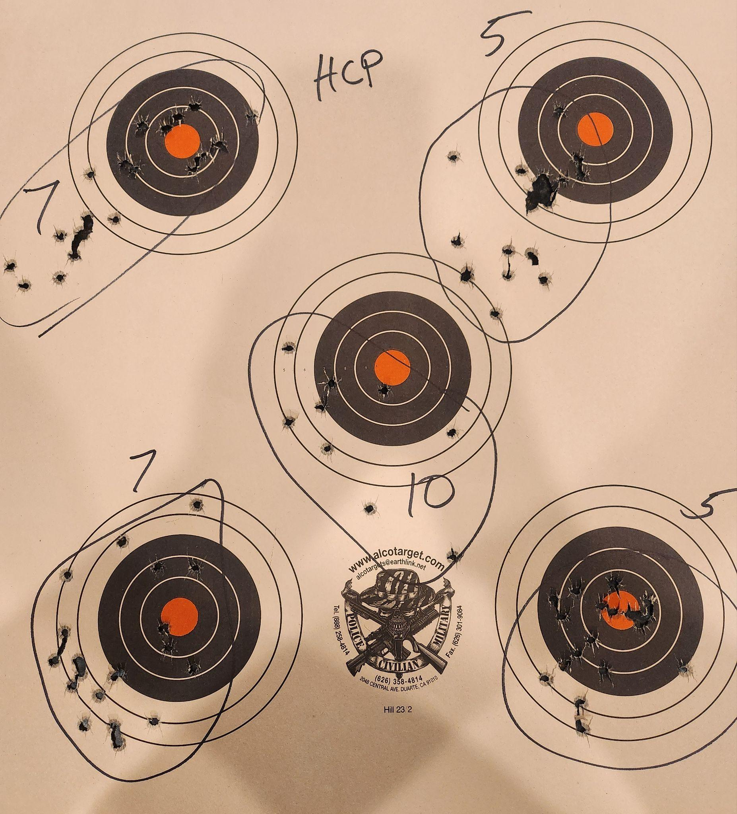
Date: 1/10/25
Guns:
HCP
CZ SP01
Notes:
Fired fairly quickly

Slide 33
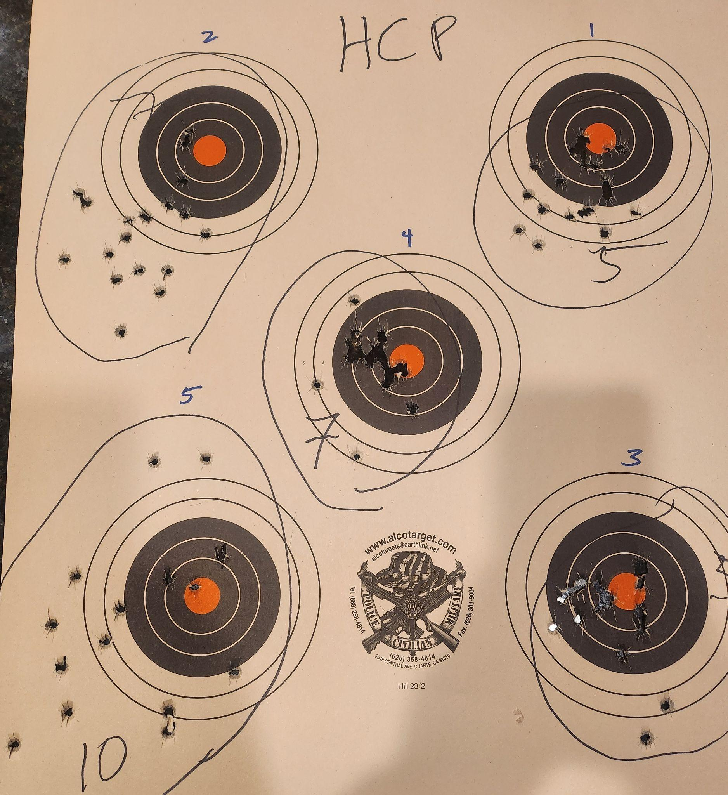
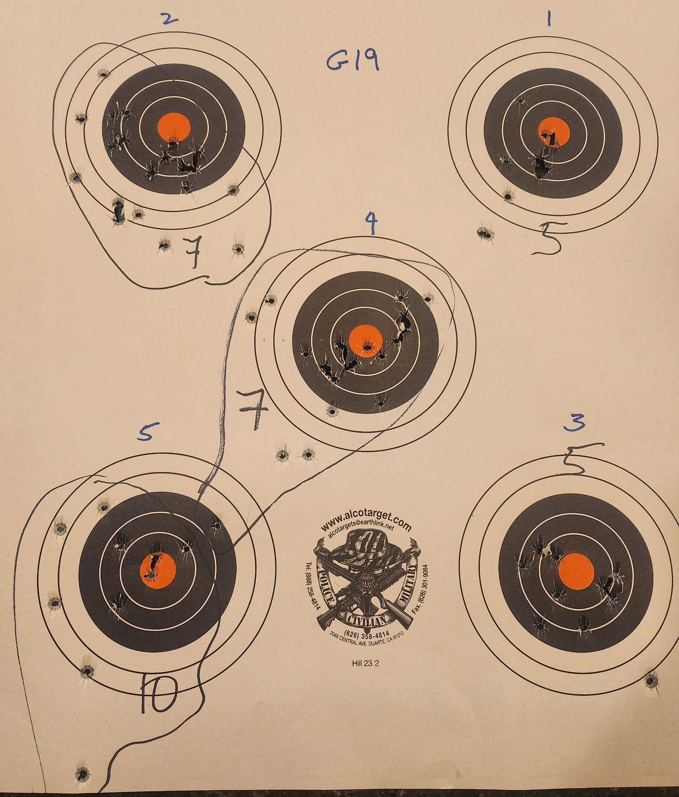
Date: 1/9/25
Guns:
HCP
G19
Notes:
***Don’t try to strangle the guns with a deathgrip***
On HCP at 5yds (#3), I relaxed grip a bit and improved, applied to 7yd (#4) and DAMN.

Slide 34
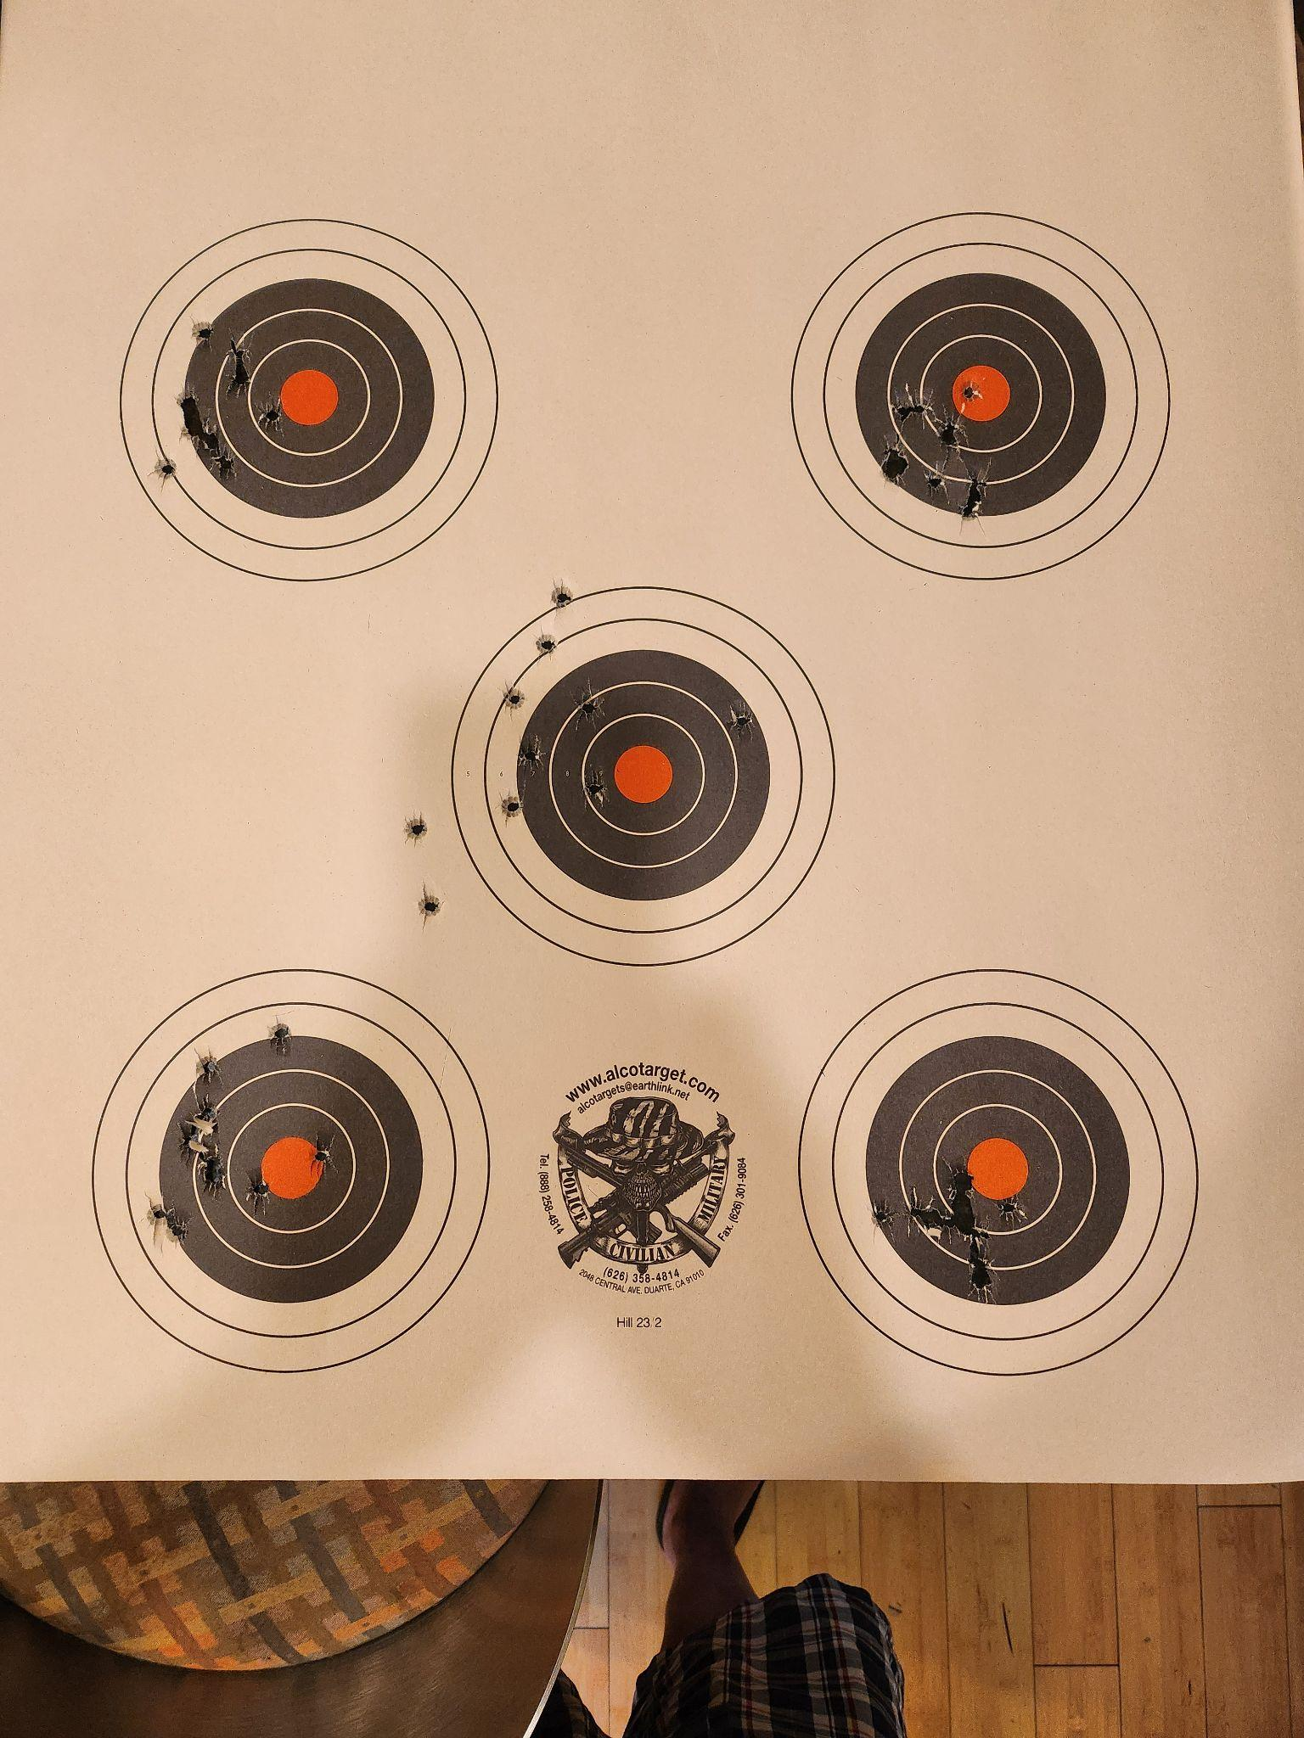
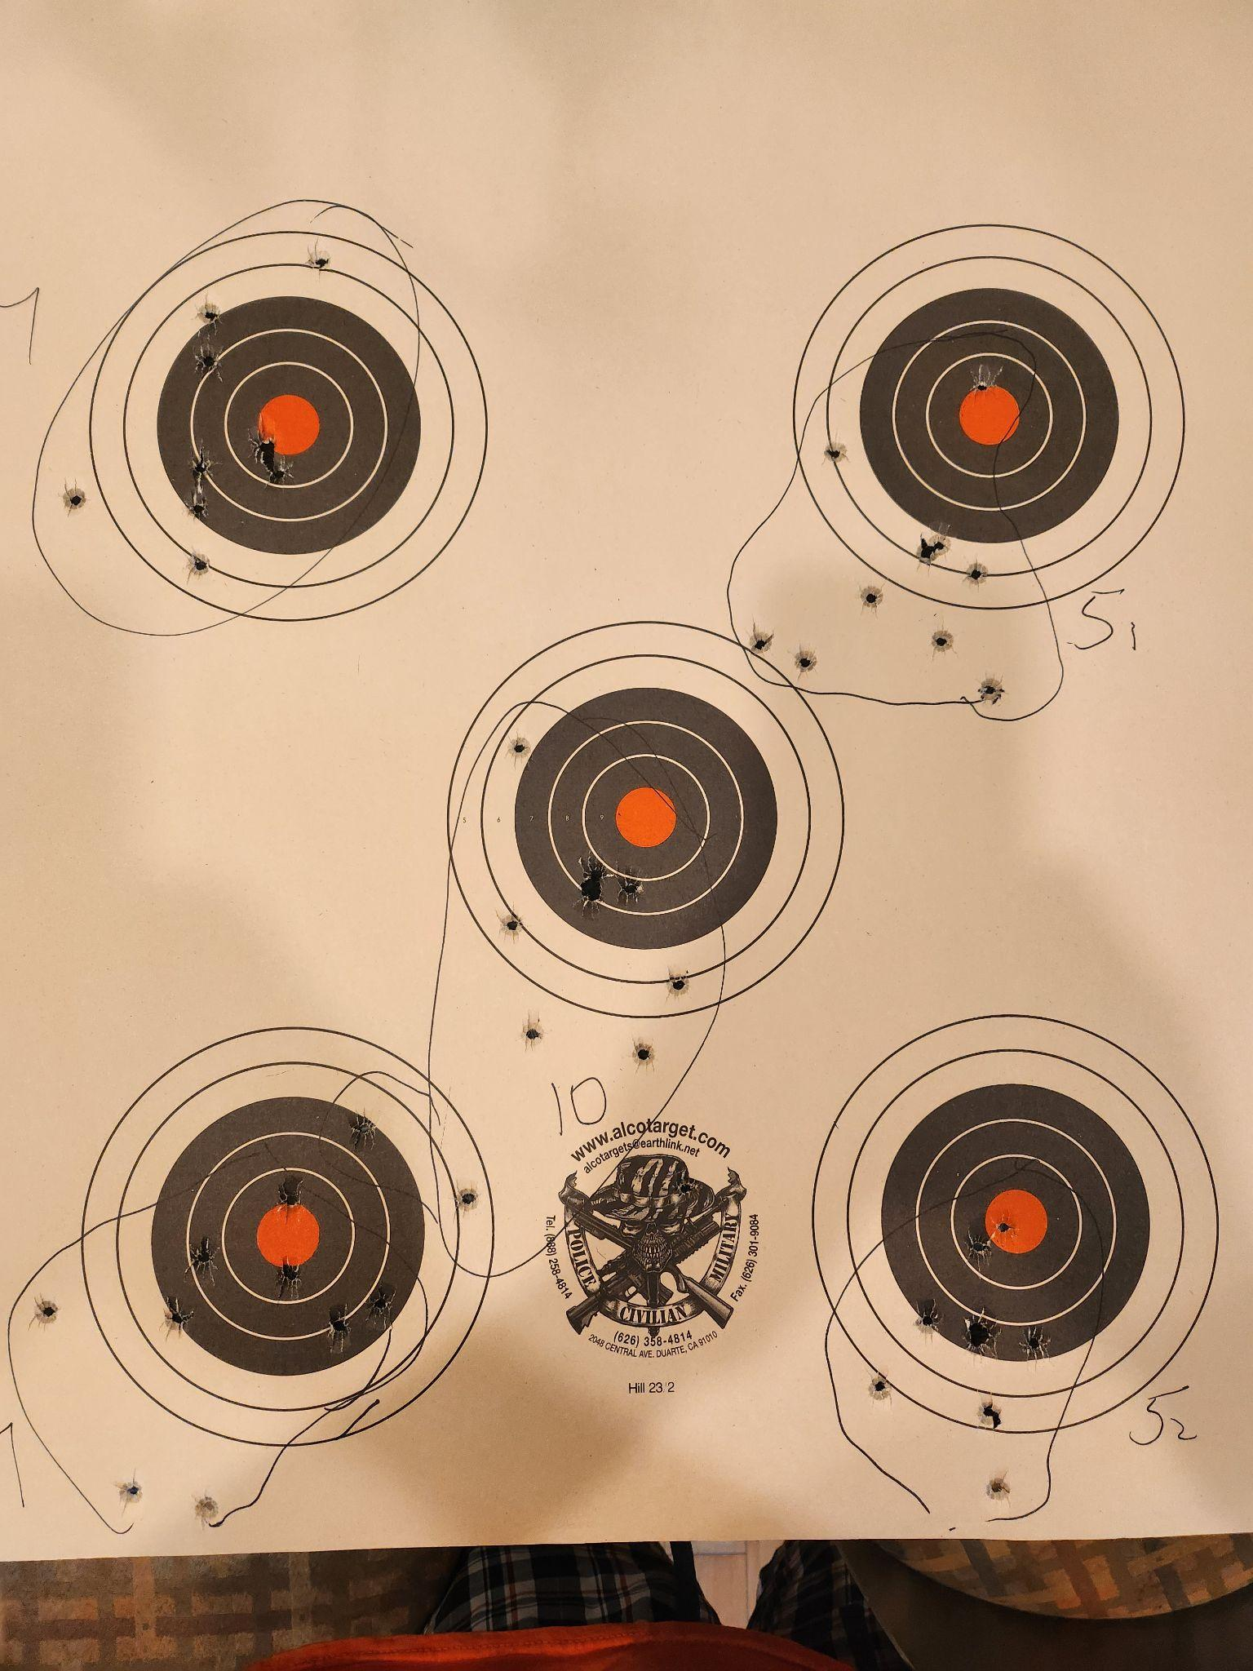
Date: 9/10/24
Guns:
HCP (50)
CZ SP01 (50)
Notes:
-HCP trigger upgrade
-Cajun Gunworks upgrade
Cajun Gunworks is amazing
7
CZ
HCP
5
7
5
10
10
7
5
7
5

Slide 35
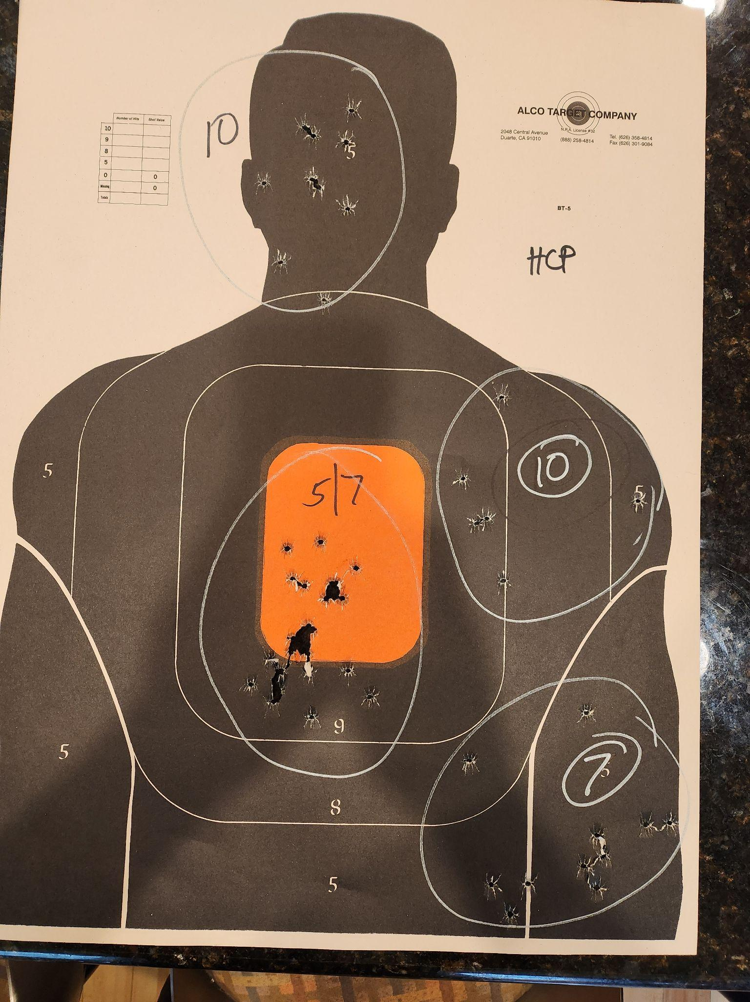

Date: 11/15/24
Guns:
HCP (50)
CZ SP01 (50)

Slide 36

Date: 11/9/24
Guns:
Glock 19.3 (80)
HCP (80)

Slide 37

Date: 9/10/24
Guns:
Glock 19.3 (100)
CZ SP01 (100)
(20 each target)
Notes:
Glock
- FTE again
- removing tungsten guide rod
CZ
-
What the fuck happened @ 10 yards?!

Slide 38
Date: 8/28/24
Guns:
Glock 19 (50)
CZ SP01
Notes:
Glock
- FTE
- new guide rod helps?
- weight of light definitely helps
CZ
- disappointing

Slide 39
Date: 8/21/24
Guns:
Hellcat Pro (50)
Notes:
Numbers indicate order of targets
Feels great in hand
Snappy as hell
Wedge grip (W)
5yds

Slide 40
Date: 8/21/24
Guns:
.38 Special (30)
CZ SP01 (50)
Notes:
CZ
Wedge grip works
Left hand tight, right more relaxed
Left arm locked straight, right not (helps keep sights in front of right eye, as a benefit)
.38
Target should sit right above sights
Impossible to control shooting DA
5yds
5yds

Slide 41
Date: 8/9/24
Guns:
Glock 19
50 + 30 shots
7
15
7
5
5

Slide 42
Date: 8/9/24
Guns:
CZ75 SP01
50 + 30 shots
15

Slide 43

Date: 7/24/24
Guns:
CZ75 SP01
50 + 51 shots
New sights, good
LOW AND LEFTb but improving
15 YDS

Slide 44


Date: 7/9/24
Guns:
CZ75 SP01
50 + 54 shots
horrible sights
LOW AND LEFT

Slide 45


Date: 5/8/24
Guns:
G19 & CZ75B
50 + 50 shots
Loved the CZ (fit, low recoil, but horrible sights).
Gonna be getting a
CZ SP01 Tactical (edit: not CA compliant)
LOW AND LEFT
G19

Slide 46


Date: 4/24/24 Gun: G19 Gen3 & Colt Trooper Mk3 .357
2 shots, reset (10s), 2 shots….
Colt
5yds
Fucking loud, kinda terriying
Colt
5yds

Slide 47


Date: 4/22/24 Gun: G19 Gen3

Slide 48


Date: 4/17/24
Gun: G19 Gen2
FTE (1)
100 shots
Mantis:
81.4 avg
96.9 max
54.6 min
8yds
8yds

Slide 49



Date: 4/15/24
Gun: G19 Gen3
Notes: Lots of duds in the old ammo

